Slide 1
Making the Journey from a Traditional Model to an Online Model
Jenny Shrensker and Nazire Koc
Focus on Teaching and Technology Conference
UMSL
November 14, 2014

Slide 2
Background
There is an increasing demand by students for more introductory online courses and more online resources in traditional courses.
The key to success in any introductory course is to have the students actively involved in the learning process.
This session will highlight four teaching techniques that make use of technology, engage the learner, and can be incorporated into any type of course for any subject.

Slide 3
Introduction
Online Basic Probability and Statistics
Designed for Business Majors
First semester of a two-semester sequence
Began incorporating technology in 2007
Online Basic Calculus
Designed for Business Majors
One-semester course
Began incorporating technology in 2006
Both courses ultimately transitioned from a traditional lecture model into two delivery systems—hybrid and online

Slide 4
Models Used Along the Journey
Traditional Model
Traditional lecture format with no technology
Supplemental Model
Traditional lecture format with technology–based homework, quizzes, and review materials
Replacement Model
Less face-to-face lectures, additional technology included
Hybrid/Online Model
All resources for students are available online

Slide 5
Side-by-Side Comparison
Math 1105
Math 1100
Traditional Model
Face-to-face Lectures
No Technology
Supplemental Model
Face-to-Face Lectures
Online Homework
Replacement Model
Elimination of Lecture, Addition of Lab time and Pencast Videos
Online Homework, Quizzes
Video Lectures
Online Homework, Quizzes, and supplemental learning activities
Hybrid/Online Model
Traditional Model
Face-to-face Lectures
No Technology
Supplemental Model
Face-to-Face Lectures
Online Homework, Quizzes
Hybrid/Online Model
Pencast Lectures, Educreation
Online Homework, Quizzes
Replacement Model
More computerized environment
Less face to face lecture

Slide 6
From Traditional to Supplemental
Online Homework Systems
Practice and repetition in mathematics is crucial for the students, so online homework enables students to master the topics
Most publishers have online homework systems to supplement their textbooks
Various levels of support for students
Cengage vs Mymathlab
Students are actively involved in thinking about concepts and working problems

Slide 7
Examples
Learning Aids in Mymathlab
Help Me Solve This
View an Example
Video and Animation
Textbook
Ask My Instructor
Learning Aids in CengageNow
Ebook link
Some short video tutorials
Notes:
Open up Mymathlab and CengageNow

Slide 8
Benefits:
Students get many attempts on the same type of question with randomized numbers on each attempt
Students receive immediate feedback of right/wrong
Students have immediate help available in the form of hints, similar examples, video tutorials, or a direct link to the textbook
Students can email the homework to their instructor as an attachment and ask questions
Students are more accountable for finishing assignments on time
Easily graded
Notes:
Please check item 4?????

Slide 9
Online Quizzes (Mymathlab)
Multiple choice questions, timed, and the learning aids are not turned on.
Students can review their work, seeing their answers as well as the correct answer for any problem that they miss after the due date of the quiz
Students assess their own mistakes while trying to figure out where they went wrong
The hard-copy of the quiz work is turned in class to mark the notation errors

Slide 10
From Supplemental to Replacement
Online Quizzes
Each week, I have my students take a 10-question multiple choice quiz covering the content from the lectures
Why multiple choice instead of other formats?
Matches with assessments of 2nd semester course
Created “distractor” answers using common mistakes so that based on their choice, I know what common mistake they made
Immediately upon submission, students see their answers, correct answers, and hints on how to correctly work the problems

Slide 11
Preventing cheating in a non-proctored environment when solutions are provided
Each quiz has a random block design
About 10 versions of each of the 10 questions
Easy to create using different numbers, or changing from “greater than” to “less than”, etc.
Each version tests the same skill
Computer randomly selects one version of each problem for each student
There are about 10¹⁰ (10,000,000,000 or ten billion) possible quizzes each week.

Slide 12
Benefits
Immediate feedback each week on which concepts were mastered and which require further studying
Feedback corrects any misconceptions
Students never “lose” their quizzes
Provides additional examples with hints to use when studying for exams

Slide 13
How are students actively involved?
First the students attempt all questions on the quiz
Upon submission, they are strongly encouraged to review their mistakes and use the feedback to rework the problems that they missed
Students are:
READING the questions
WORKING problems
REVIEWING their answers
CORRECTING mistakes

Slide 14
Pencast Videos
Need to supplement lectures due to decreased lecture time.
Began as additional example problems
Thinking ahead to an online course, they can also be used as guided practice.
Pencast videos with worksheets provide help at whatever step in the problem students struggle with.
Notes:
Show pencast example

Slide 15
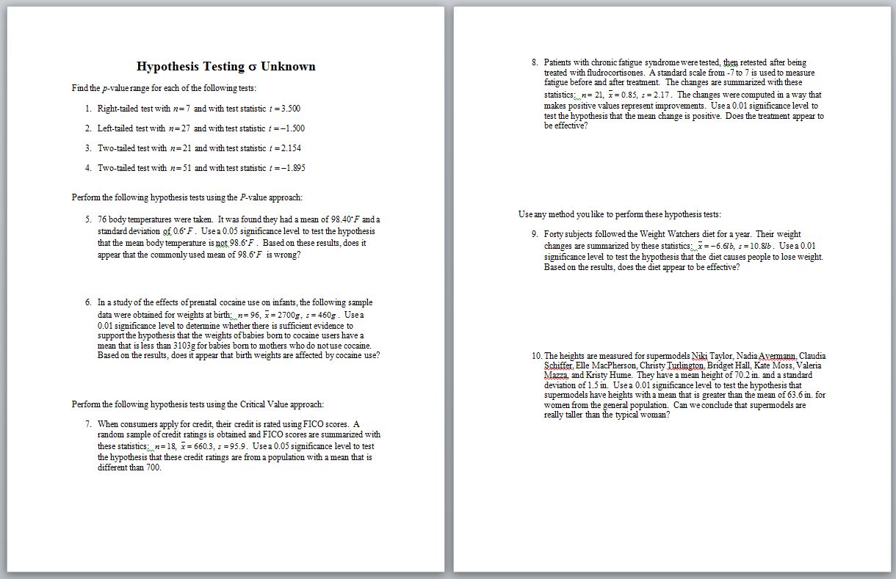
http://www.livescribe.com/cgi-bin/WebObjects/LDApp.woa/wa/MLSOverviewPage?sid=4mMgLXmhxszq

Slide 16
From Replacement to Hybrid/Online
Pencast/LiveScribe
The biggest obstacle in presenting course lectures online in any mathematics course is the lack of software availability
Used for answering questions by email.
Used for delivering Basic Calculus lectures online
http://www.livescribe.com/cgi-bin/WebObjects/LDApp.woa/wa/MLSOverviewPage?sid=p1ZGxprdD4Jh
Notes:
Will show example right after this slide if it is necessary and time permits.

Slide 17
Benefits as a lecture supplement:
Easy to skip ahead to any part of any problem to customize the guidance to each student
Can be used in many different ways:
simply to check answers
to correct a computational or conceptual error
to get help with one or more steps of a problem
it can be watched in its entirety to act as supplementary examples to the lecture or as the lecture itself

Slide 18
Benefits as a lecture tool:
It records everything the instructor says and writes, linking the explanation to the notes
Students can use the navigation window to stop or replay at some point during the video
Students can print what was written on the pencast video in pdf format, and work on it
Classroom students benefit by:
Knowing what should be included in their notes
Having legible notes to study from
Being able to replay the lectures to catch any details that were overlooked
Notes:
I kind of combined your two “benefits” into one here…Remove the other two if you think this is okay. Or remove this one if not.

Slide 19
Educreations for iPad
What is it?
A whiteboard feature that captures handwriting and voice of the user using the iPad
You can import pictures/diagram and draw on them
Post the lectures and/or answer students’ questions
It is free
Online students prefer using this software
http://www.educreations.com/lesson/view/oldtest21/17202648/?s=H6RBS6&ref=app
Notes:
Pull up educreations

Slide 20
Benefits
Educreation is easier to use for teachers and students
I record my explanation using this software and send the link to the student and then student can click the link and listen to the answer to their question
There can be multiple pages, this means you don’t have to explain everything in a single page
Students can record their questions and send it as an email attachment

Slide 21
How are the students actively involved?
Students listen to my explanation through the Educreation app on the iPad
Students explain their work using this app
Students also ask their questions using this app when they cannot figure out certain part in their work

Slide 22
Video Lectures

Slide 23
How are students actively involved?
They READ the definitions and explanations
They WATCH the instructor do examples
The LISTEN to the explanations
They WRITE down notes and TRY working problems
Fill-in-the-blank lecture notes vs completed notes or powerpoint slide print-offs (active vs passive learning)

Slide 24
Smartboard allows students to see the instructor work through a problem in the same manner that they would.
Draw graphs
Write complicated formulas
Circle/highlight important facts
Easily refer back to previous items in the notes to draw comparisons
Reference tables for specific values
(Example video)

Slide 25
Benefits
Face-to-face component with instructor
Pull in additional resources, such as tables, charts, websites, etc. without little confusion to the student
Students can go at their pace, rewind, listen to explanations again and again.

Slide 26
The Journey is Never Complete…
Constant adjustments each semester to meet new educational needs of students, to improve existing materials, etc.
New technologies become available to incorporate
Currently adding Showme videos to 1105 (similar to Educreation App)
Examples: www.showme.com/Jenny-Shrensker
The redesign of Basic Calculus’ hybrid section is in progress through Online in 9 Program.

Slide 27
Discussion and Follow-up
For further discussion beyond the conference, feel free to contact us at shrenskerj@umsl.edu or kocn@umsl.edu

