Slide 1
Elevating the Discussion
Challenging Ideas in the Online Format
Fatemeh Mardi

Slide 2
Welcome

Slide 3
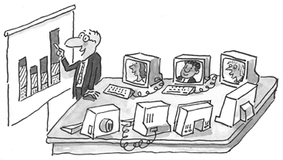

Slide 4
Notes:
http://www.umsl.edu/divisions/business/About%20the%20College/Administrators%20and%20Staff.html

Slide 5
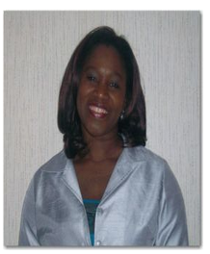
Notes:
http://www.siue.edu/artsandsciences/socialwork/faculty_staff.shtml

Slide 6
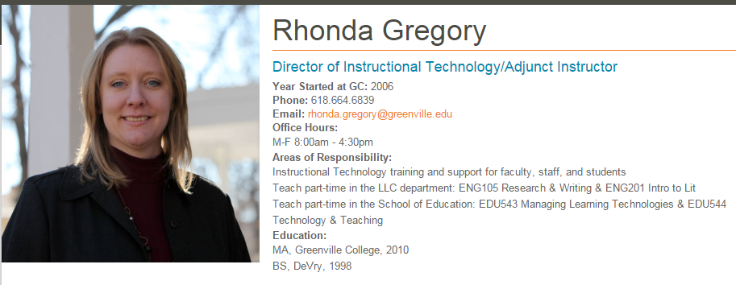
Notes:
http://www.greenville.edu/academics/faculty_staff/rhonda-gregory

Slide 7
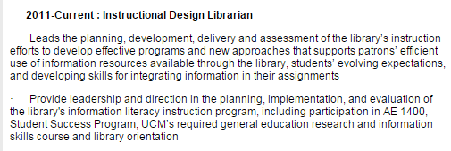
Notes:
http://guides.library.ucmo.edu/Hallis-Vita

Slide 8
Chalice Jeffries University of Central Missouri

Slide 9
Notes:
http://www.ucmo.edu/centralnet/staff.cfm

Slide 10
Notes:
https://www.linkedin.com/in/lkovarik

Slide 11
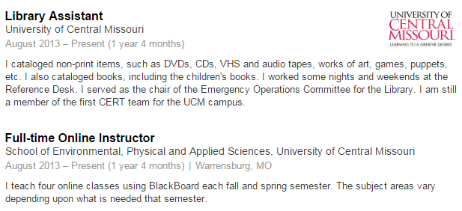
Notes:
https://www.linkedin.com/pub/linda-lengfellner/26/943/ba6

Slide 12
Notes:
https://www.ucmo.edu/elhd/facstaff/neal.cfm

Slide 17
Moving on…why are we here?
by Marisa Anne
Notes:
Now that you know what I am talking about, I’d like to move on to the importance of discourse and argumentation.

Slide 18
Elevating the Discussion
Challenging Ideas in the Online Format

Slide 19
What & How you ask… is related to how students answer.
You know that right?

Slide 20
Why ask questions?
Focus attention
Promote recall
Increase sense of community
Exchange ideas
Reflect on course material
Build an in-depth understanding of the topic

Slide 21
“Online discussions should be carefully constructed or the circumstances conducive to promoting higher-order thinking may not arise.”
“By modifying the types of questions asked, faculty could more readily target the kinds of learning outcomes they wished their students to obtain.”
“Teacher’s usage of low-level questions in online discussions can actually discourage student participation and thus, limit their opportunities to interact with the content, think critically, and ultimately, to learn.”

Slide 22
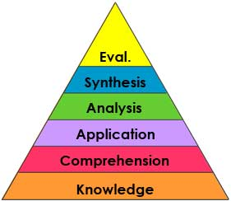
Ertmer, Sadaf, & Ertmer 2011
Question Type &
Student Responses (levels of Critical Thinking)
19 discussion forums from 10 courses

Slide 23
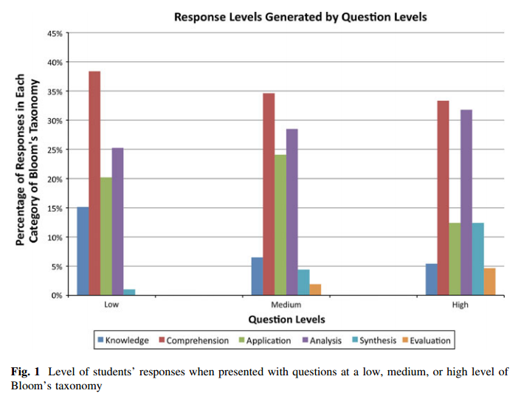

Slide 24
Brainstorm (BS)
Focal question (FQ)
General invitation (GI)
Lower-level divergent (LD)
Analytic convergent (AC)
Playground (PG)
Shotgun (SG)
Funnel (FUN)
Critical incident (CI)

Slide 25
Notes:
Have two people read them – then ask if any not clear

Slide 26
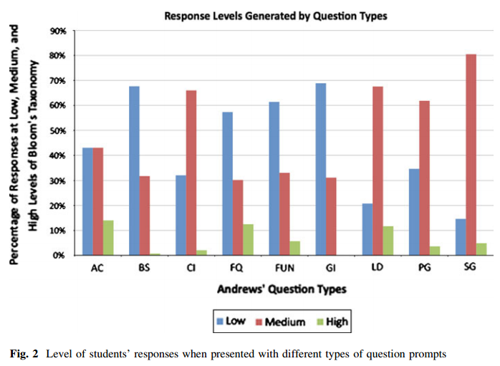

Slide 27
General invitation & Brainstorm: greatest # of responses -
exchange ideas, search for explanations, and use personal opinions to support their arguments
Lower-divergent:
Most effective med/high level response generation
integrate material from multiple sources and to connect relevant ideas from previous discussion posts to support their opinions or decisions

Slide 28
Brainstorm (BS)
Focal question (FQ)
General invitation (GI)
Lower-level divergent (LD)
Analytic convergent (AC)
Playground (PG)
Shotgun (SG)
Funnel (FUN)
Critical incident (CI)

Slide 29
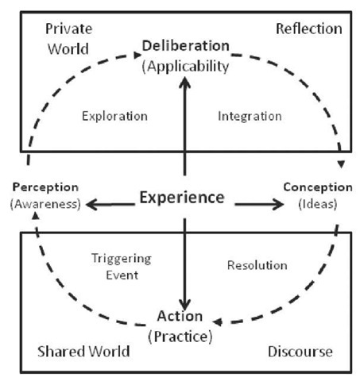
Practical Inquiry Model 1) Trigger 2) Exploration 3) Integration 4) Resolution

Slide 30
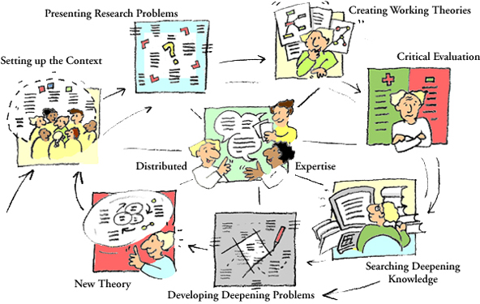

Slide 31
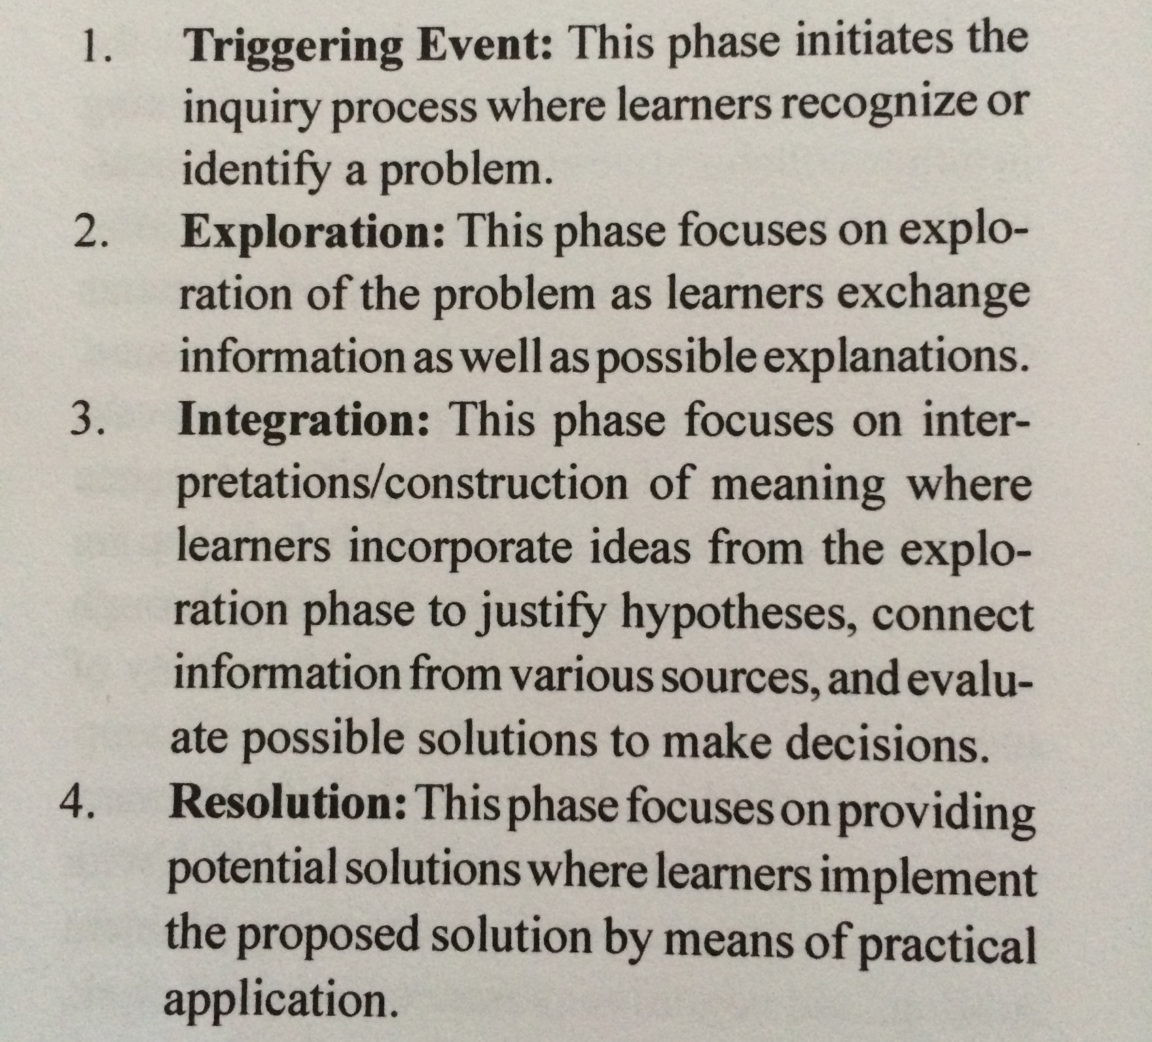

Slide 33
Brainstorm (BS)
Focal question (FQ)
General invitation (GI)
Lower-level divergent (LD)
Analytic convergent (AC)
Playground (PG)
Shotgun (SG)
Funnel (FUN)
Critical incident (CI)
Generate Med/High
Level
Responses

Slide 35
Brainstorm (BS)
Focal question (FQ)
General invitation (GI)
Lower-level divergent (LD)
Analytic convergent (AC)
Playground (PG)
Shotgun (SG)
Funnel (FUN)
Critical incident (CI)
High
#3 Integration
#2
Exploration
High
#4
Resolution

Slide 36
“If the goal of online discussion is to facilitate higher levels of critical thinking, then discussion questions that fall within the Critical Incident (CI) types have been shown here to be highly effective.
“CI questions require original evaluative thinking to create solutions to authentic problems can help students to think in more complex ways to produce a higher level response.”
“Allowing for or even asking students to provide personal observations and experiences may also promote responses that are at a higher critical thinking level.”

Slide 37
Disciplines, call for certain question types?

Slide 38
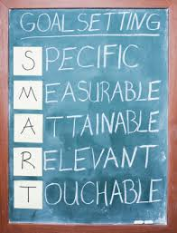

Slide 39
Moving on…my course
by Marisa Anne
Notes:
Now that you know what I am talking about, I’d like to move on to the importance of discourse and argumentation.

Slide 40
ED TECH 3135 Technology for Educators
Instruct teacher candidates in the
use of digital tools
in education.
"Strategies to incorporate current technology
into practice"
Notes:
The course was so new that it had only been piloted once before. By three instructors to 6 students. There was a hint of a syllabus and not much else. The bulletin description was vague. “Instruct teacher candidates in the use of digital tools in education.” The preservice teachers needed to learn “Strategies to incorporate current technology into practice.” This new course was a mandatory course for education majors.

Slide 41
Course goals?
Demonstrate increasing confidence using various types of tech.
Develop concrete examples of using technology.
Notes:
I set up two meetings with the individuals who team-taught the course and tried to make sense of what was going on. I quickly found out there were no clearly defined course goals yet. So we cranked them out: Course goal number one: Develop concrete examples of using technology. Course goal #2: Demonstrate increasing confidence using various types of tech.

Slide 42
Challenge experience
Demonstrate willingness to challenge others’ ideas and effectively present own ideas with technology.
Ideas are…
Presented
Discussed
argued about
rethought
Notes:
The third course goal was for the students to experience a challenge. The department chair wanted students to exchange ideas and challenge them. This is where this presentation comes into place.

Slide 43
Who are my students?
Notes:
My students are primarily third and fourth year education majors. Middle school and High school: math, science, English, art. Special ed, early childhood, and a few will earn education degrees without certification. Lots of young, white, females would be the most general and oversimplified description of my students’ demographics.

Slide 44
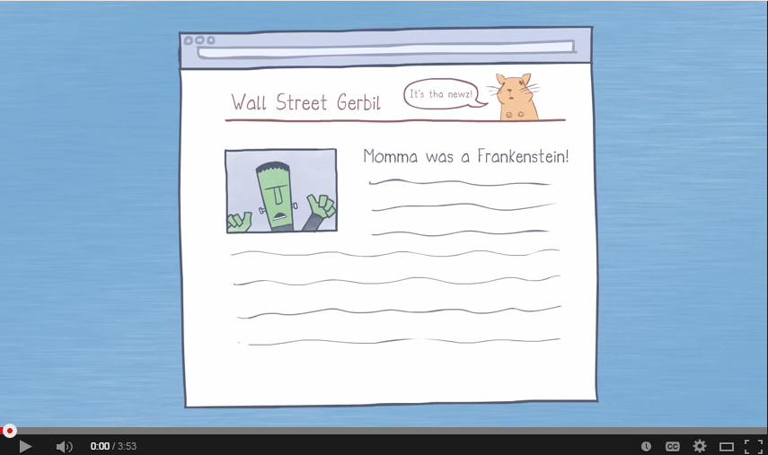
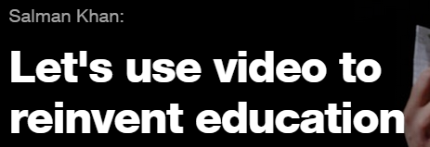
EdTech 3135: Spring 2014

Slide 45
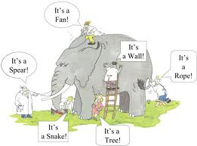
EdTech 3135: Spring 2014
Question:
Is using technology
Helping or hindering
student attention span?
Create buy-in
Dichotomous
Relevant
Narrowed down

Slide 47
Brainstorm
Discuss
Take Position
Draft Position
Notes:
These are the four main steps of the process. Brainstorm – Draft position – Oral discussion – Final position. We will go through each step. But first…

Slide 48
Notes:
I’d like to show you a powtoon that I made, giving you an overview of the process.

Slide 49
Moving on…tools for the discussion
by Marisa Anne
Notes:
Now that you know what I am talking about, I’d like to move on to the importance of discourse and argumentation.

Slide 50
padlet.com/fatemehmardi/FTTC
Double Click
Type Gmail address

Slide 52
Notes:
Do you have experience using Google Calendar? https://www.polleverywhere.com/multiple_choice_polls/rR99XsV3drzpbZY

Slide 53
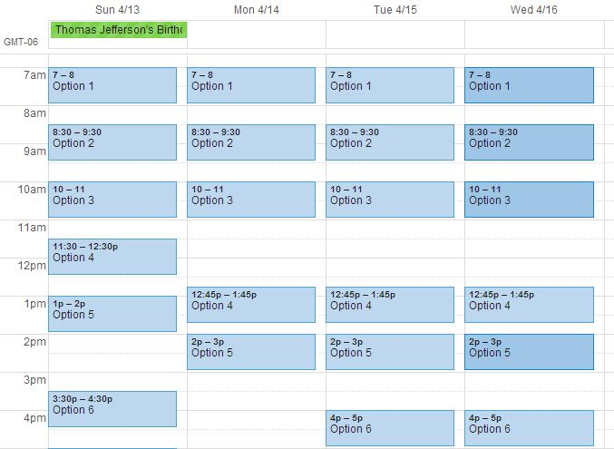
Notes:
How we actually get together on time is through Google Calendar. I put in my available times for two weeks of the semester. I place multiple morning and evening options on the calendar and give them a deadline to make a decision. The teams will select a slot and make it red. My schedule usually ends up having a maximum of two team in a day. So over the course of 7 days, I saw my 20 students and participated in the discussion with them. I will continue to talk about the scheduling issues in the logistics part towards the end.

Slide 54
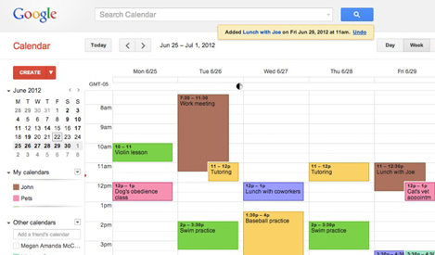
Create calendar
Create email list
Create event
Add video call
Add doc/ppt
Repeat event
SAVE
Share calendar

Slide 55
Notes:
Do you have experience using Google Hangout? https://www.polleverywhere.com/multiple_choice_polls/JlhFXTQ772LkEAG

Slide 56
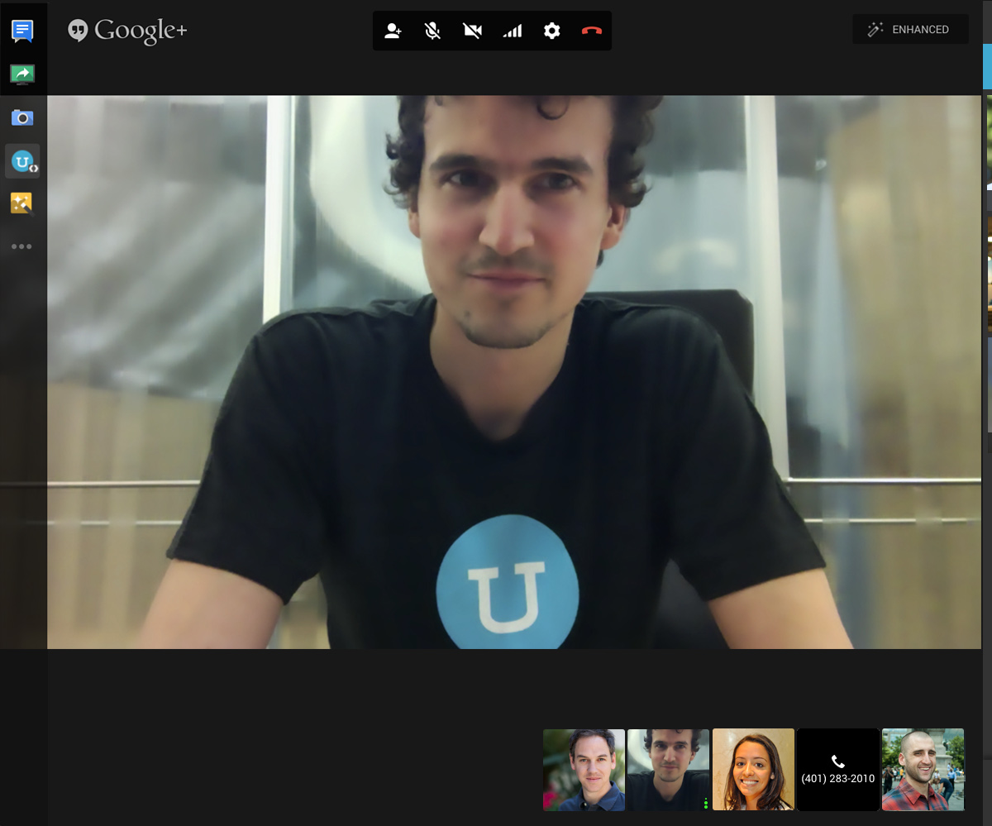
Join a hangout
Invite someone
Send link to join
Share desktop

Slide 57
Notes:
What do you use to create screencasts or record your screen? https://www.polleverywhere.com/multiple_choice_polls/HjX4hpfp6SMWx5G

Slide 58
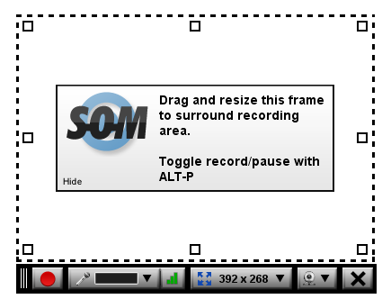
Screencast-o-matic
Adjust screen
Add webcam
Record
Edit
Save

Slide 59
How do you use Google Drive in your classrooms?

Slide 60
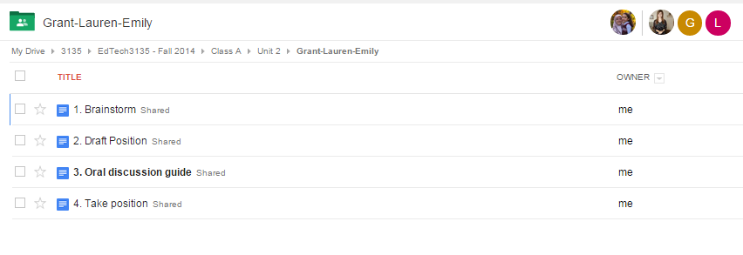

Slide 61
Real time – Cursor magic
Highlight
Comment bar
Share the doc
Enter in email addresses (share Whacky cards)
https://docs.google.com/document/d/1p-jWm5zZYk3-SiyQ-CF3M4YAsOPR3KO010tOuhDe7a4/edit?usp=sharing

Slide 62
Moving on…getting psyched
by Marisa Anne
Notes:
Now that you know what I am talking about, I’d like to move on to the importance of discourse and argumentation.

Slide 63
How do I set the stage for the discussions?
How do I try to model
critical thinking?

Slide 65
Comments? Takeaways?
Disprove her … Create conflict
Thinking partners … not echo chambers
1. Constructive Collaboration & Criticism
2. Sense of Community
3. How to partner up?

Slide 66
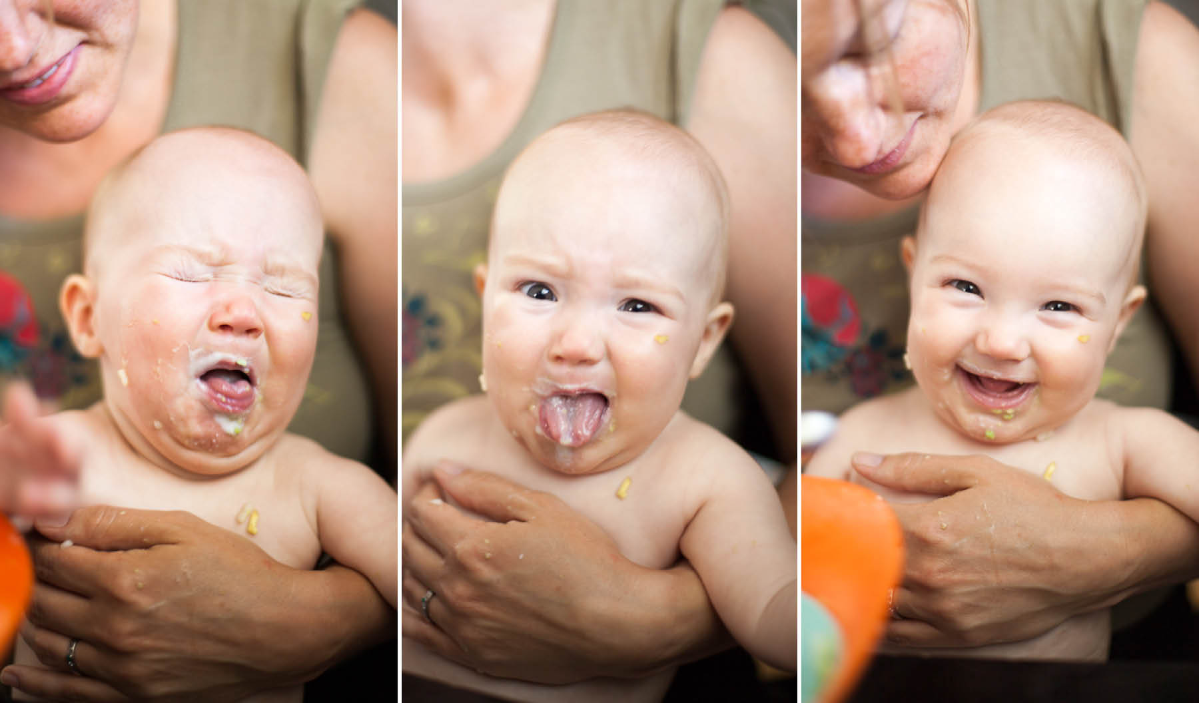
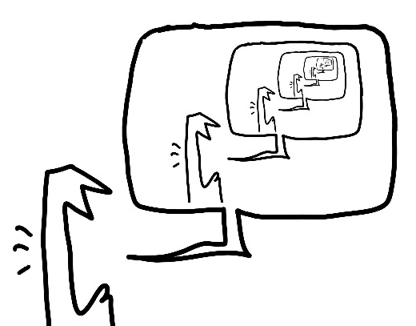
Constructive Collaboration & Criticism
by Dan Morris
Notes:
Nobody said constructive collaboration and criticism were going to be fun. It pays off in the long run though. Having a thinking partner instead of being in an echo chamber will push you to do better and to be better. The goal behind experiencing an idea challenge is to improve students’ thinking, writing, and oral presentation of ideas.

Slide 67
Why?
Notes:
Why is argumentation important specifically to my students? As education majors, my preservice teachers need to teach this in almost every subject and grade level. The common core heavily emphasizes argument writing starting in the sixth grade. The Next Generation Science Standards practices “engaging in argument from evidence”. The 21st century identifies four learning and innovation skills, which argumentation covers : critical thinking, creativity, communication and collaboration.

Slide 68
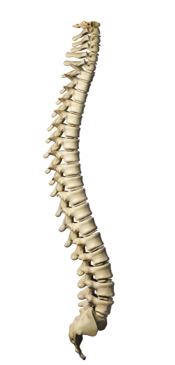
Sense of Community = Backbone of Argumentation
=
Notes:
I recently attended a two-day conference on argument writing. I get very excited at these events, and usually I don’t do a good job of hiding my enthusiasm. We were assigned to be in teams of four at about noon the first day. Gifted instruction, history, ELA, and me. We don’t know each other, we just have a clear goal- to complete the task assigned to us. After saying two things, both times being shut down in a rude and harsh way, I learned my lesson in argumentation. I would not say anything more, Mrs. Gifted Instruction saw the way I was treated and didn’t say anything, she just nodded when they asked her opinion. For collaboration to be effective, you need to establish norms, not just write them on the board. Creating sense of community is the precursor and backbone of argumentation, particularly in an online classroom.

Slide 69
A. Similar or diverse?
B. Rotate or long-term?

Slide 70
Moving on…discussion process
by Marisa Anne
Notes:
Now that you know what I am talking about, I’d like to move on to the importance of discourse and argumentation.

Slide 71
Brainstorm
Discuss
Take Position
Draft Position
Notes:
These are the four main steps of the process. Brainstorm – Draft position – Oral discussion – Final position. We will go through each step. But first…

Slide 72
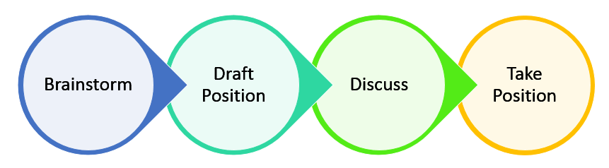
Units 2,3,4 --- Middle Section of Course
First time
4 days /// 3 days /// 7 days /// 3 days
2nd & 3rd
All steps in 90min /// 3rd time: no me
Notes:
There are two ways I set up this process: a stretched out way and a compact way. In Unit 2, students are learning to use the tools along the way, so we take it slowly. I post what’s going on in advance so they have time to schedule the first oral discussion. The process is basically stretched out over the whole length of the unit. In Unit 3, students schedule blocks of 90 minutes and do the whole process in one sitting. I give them up to 2 hours after we hang up to hand in the final position paragraphs. In Unit 4, I go back to the stretched out format. Each one has pros and cons, and I will evaluate the effect the formats have on student writing this fall.

Slide 73
3 Discussion Prompts
Notes:
Each of the discussions starts with a prompt. What you choose to talk about and how you frame it is actually an important part of designing the discussion. I will get into more details in the logistics part at the end of the presentation.

Slide 74
Brainstorm
Discuss
Take Position
Draft Position
Notes:
The first step we are going to discuss is brainstorming.

Slide 75
Notes:
The fist time I had an argumentation piece in my online class I did not include a brainstorming section. It got very ugly. I gave my students articles and videos of both sides of a topic and started there. You can’t introduce new information until you have sorted out what you have already. Our learners come to the class with a lot of random knowledge already. Making sense of that raw data is the purpose of this step.

Slide 76
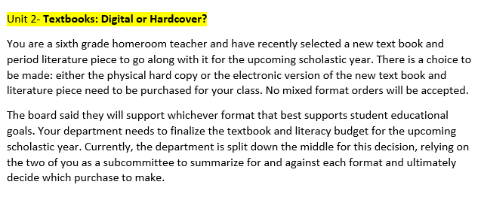
Justification
Notes:
This is the first discussion prompt students come across in Unit 2. […]
The prompt offers the context as well as the significance of the argumentation modules throughout the course. Why are we doing this? Because as teachers you have to make decisions and justify them.

Slide 77
Notes:
This is what the Brainstorming looks like in Google Drive. Students will collaborate and add to the T chart. When they are on at the same time, they each have different color cursors so they know what’s going on. They can also insert comments and suggestions on the side.

Slide 78
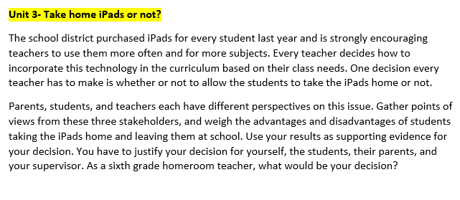
Multiple
Perspectives
Notes:
Take home iPads or not? This is the second discussion prompt. One of the research areas I have focused on over the past year and a half, is scientific argumentation. A different spin on that is SSI, socio-scientific issues. This doesn’t involve science or ethical issues directly, but it still has many of the same concepts. Like looking at the issue from different perspectives. Every discipline can relate to this on some level.

Slide 79
Notes:
In this Tchart, students have the option of choosing two stakeholders to weigh the advantages and disadvantages. So far, no one has chosen the parent or administrator perspective, but simply considering multiple perspectives in an argument is a big accomplishment.

Slide 80
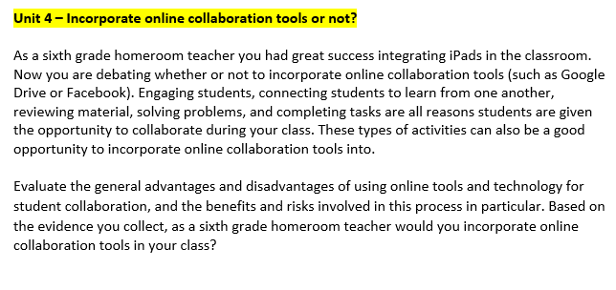
Risk Assessment
Notes:
The last discussion prompt is about incorporating online collaboration tools. Factoring in the risks of integrating technology is another takeaway for students in this unit, then weighing the risks and advantages to make a decision.

Slide 81
Notes:
Students seem to be more confident by this discussion. They know the process and the technology well. In the upcoming fall semester, I will have surveys I created using Google forms to collect self-assessment reflections on comfort levels of technology and peer interactions. Peer evaluations so far have not really given me any meaningful feedback. The comments in the beginning and end of the oral discussion were more helpful figuring out how the students are doing.

Slide 82
Brainstorm
Discuss
Take Position
Draft Position
Notes:
Step 2. Draft position. So students write a 250 word initial paragraph about the position they take and why.

Slide 83
Step 2. Draft Position
Notes:
I actually noticed how similar it is to the Think-pair-share process in traditional classrooms after I had used the process with my students twice. This step allows the student to review both sides of the issue, and support his or her decision. Then students read through what their teammates have written.

Slide 84
Brainstorm
Discuss
Take Position
Draft Position
Notes:
Now here comes the challenging part, what students are not used to an online class involving…the oral discussion.

Slide 85
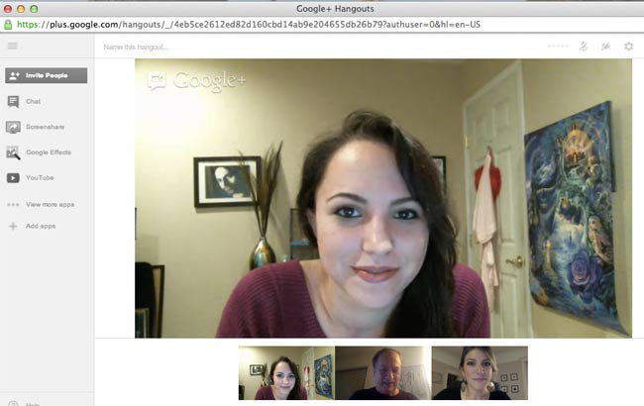
Notes:
This is kind of what Google Hangout looks like. For FERPA purposes, I can’t show you my hangout sessions with my students. But it’s almost like this. I use the screenshare function to walk them through parts of the process and attend to housekeeping matters sometimes.

Slide 86
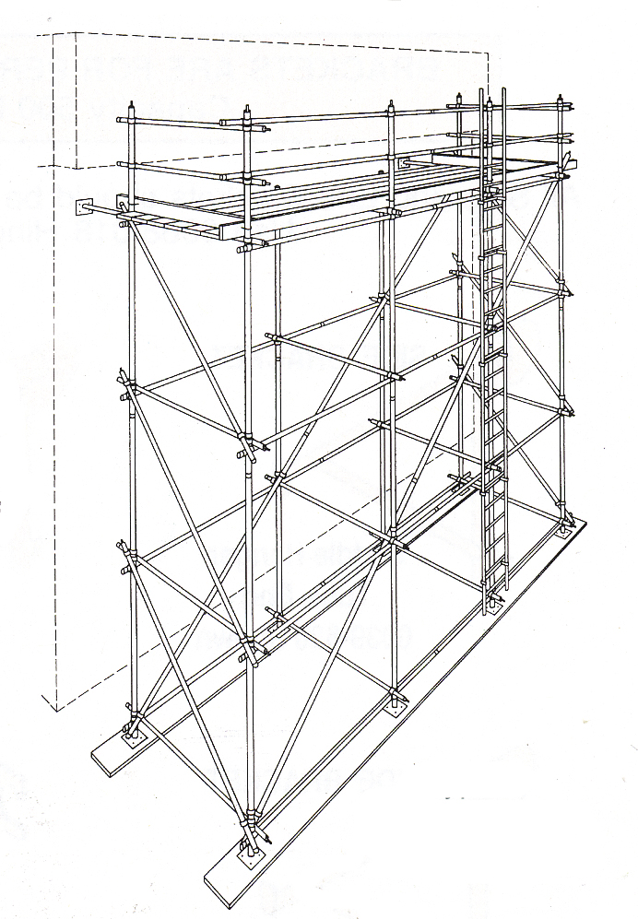
Step 3. Discuss
Notes:
The oral discussion steps are scaffolded throughout the semester when it comes to my presence. I have a strong presence and I lead and model the discussion in Unit 2. Then I participate in unit 3, but I try to jump in only when I have to. In Unit 4, they are on their own and they send me the recording of their discussion.

Slide 87
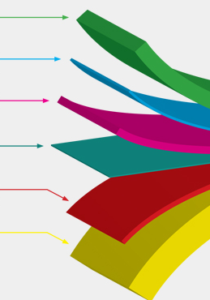
Technology comfort level
Ambiguity tolerance & Risk taking willingness
Oral speaking confidence & Writing Proficiency
Gender
Practicum: level of classroom exposure
Introvert/Extravert & Politeness factors
Notes:
Why do some of the students seem to more dominant and confident during the discussion that others? These are some of the “layers” of the dynamics between students I notice during the oral discussions.
Level of comfort with technology, sometimes it seems dominance in the discussion is related to taking lead with the technology.
More factors are their ability to not know what’s going on, their ability to take the risk and challenge their partner. Abilities they enter the course with: in speaking and in writing. Gender always seems to make a difference. There are usually fewer than 30% male students in my class, yet they always seem to dominate the oral discussion, even with weaker arguments and writing. The amount of student teaching they have done also makes a difference. They are able to grasp the context and share relevant experiences more after at least one course of practicum.
Then there are personality factors. It takes some people a lot more time to break the barriers of courtesy and politeness they feel and challenge their partner’s ideas. “I just don’t feel very devil’s advocate’y” a student said last week.

Slide 88
Brainstorm
Discuss
Take Position
Draft Position
Notes:
This is what I came here to share with you today. The process I designed after multiple failed attempts, and how I use it in my online class.

Slide 89
What I struggled with….

Slide 91
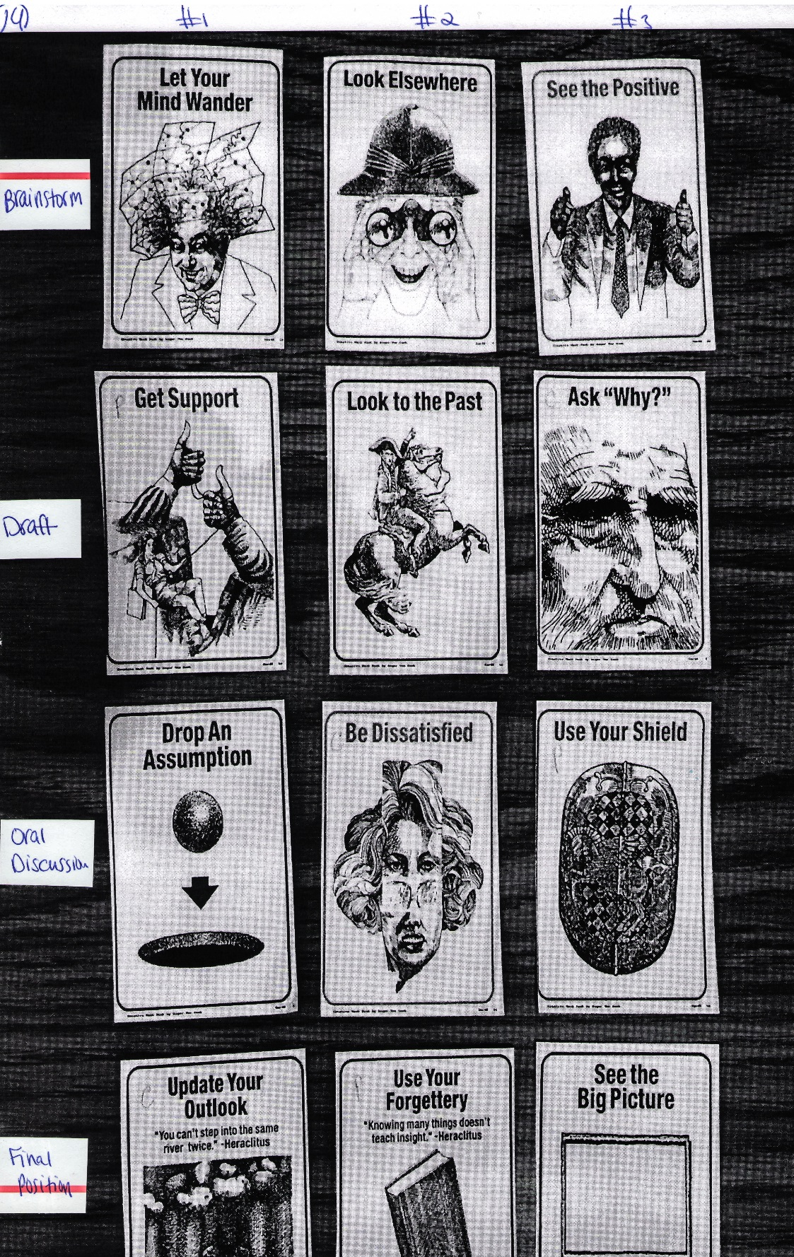
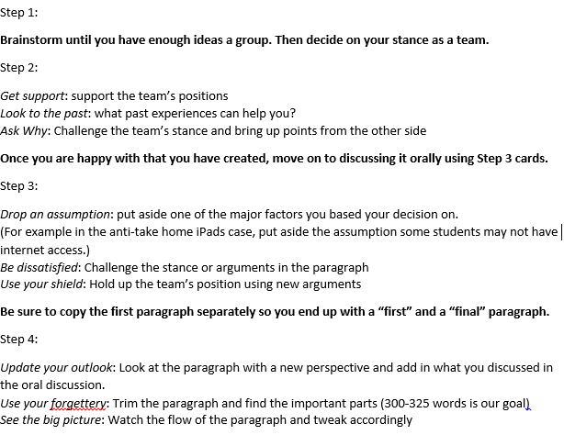

Slide 92
Moving on…let’s team up!
by Marisa Anne
Notes:
Now that you know what I am talking about, I’d like to move on to the importance of discourse and argumentation.

Slide 93
Elevating the Discussion: Challenging Ideas in the Online Format
padlet.com/fatemehmardi/FTTC

