Slide 1
Quality Discussion, Problem-Based Learning, and Authentic Assessment using Blackboard’s Discussion Board
Friday, Nov. 14, 2014
Rebecca Hodges
Dept. of Anthropology, Sociology, and Languages, UMSL
Contact: hodgesre@umsl.edu
Connect with me on Twitter (@profhodges), LinkedIn, Facebook

Slide 2
Achieved Goals
Challenged students’ thinking
Connected students to peers
Helped students practice applying content to real life

Slide 3
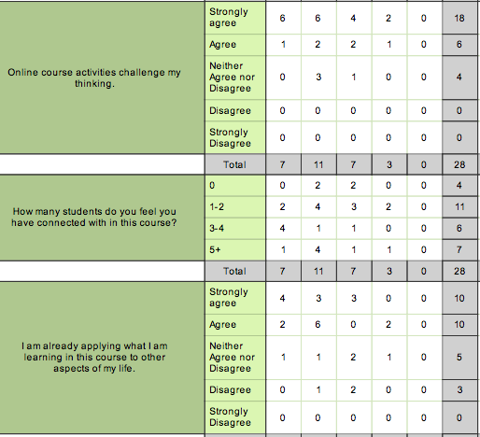

Slide 4
Design
HANDOUT: Discussion Board Weekly Post/Comment Rubric
Pass/Fail
Student Choice
Discussion Board as space for Term Project
Building on a term-long conversation

Slide 5
Weekly Discussion Board
Each student must post once (by Monday), comment twice (by Wednesday) for points. No partial credit.
A “Post” includes:
A quote from the relevant chapter, including page number
A question from the chapter or a personal query.
An answer to the question posed with reference to the quote and other material from the chapter. Personal anecdotes are also encouraged, but you must reference the ideas from the book.
Estimated 500-1000 words in essay style format
A “Comment” includes:
An answer to the question posed in the original comment using material from the chapter and personal stories.
Estimated 250-500 words in short essay style

Slide 6
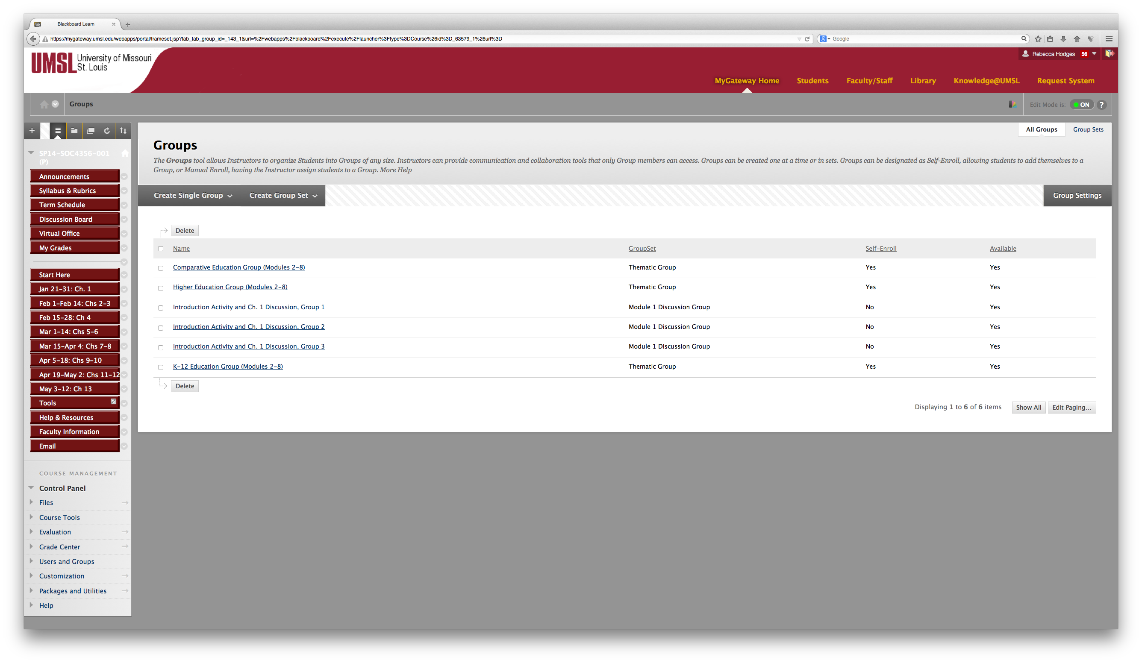

Slide 7
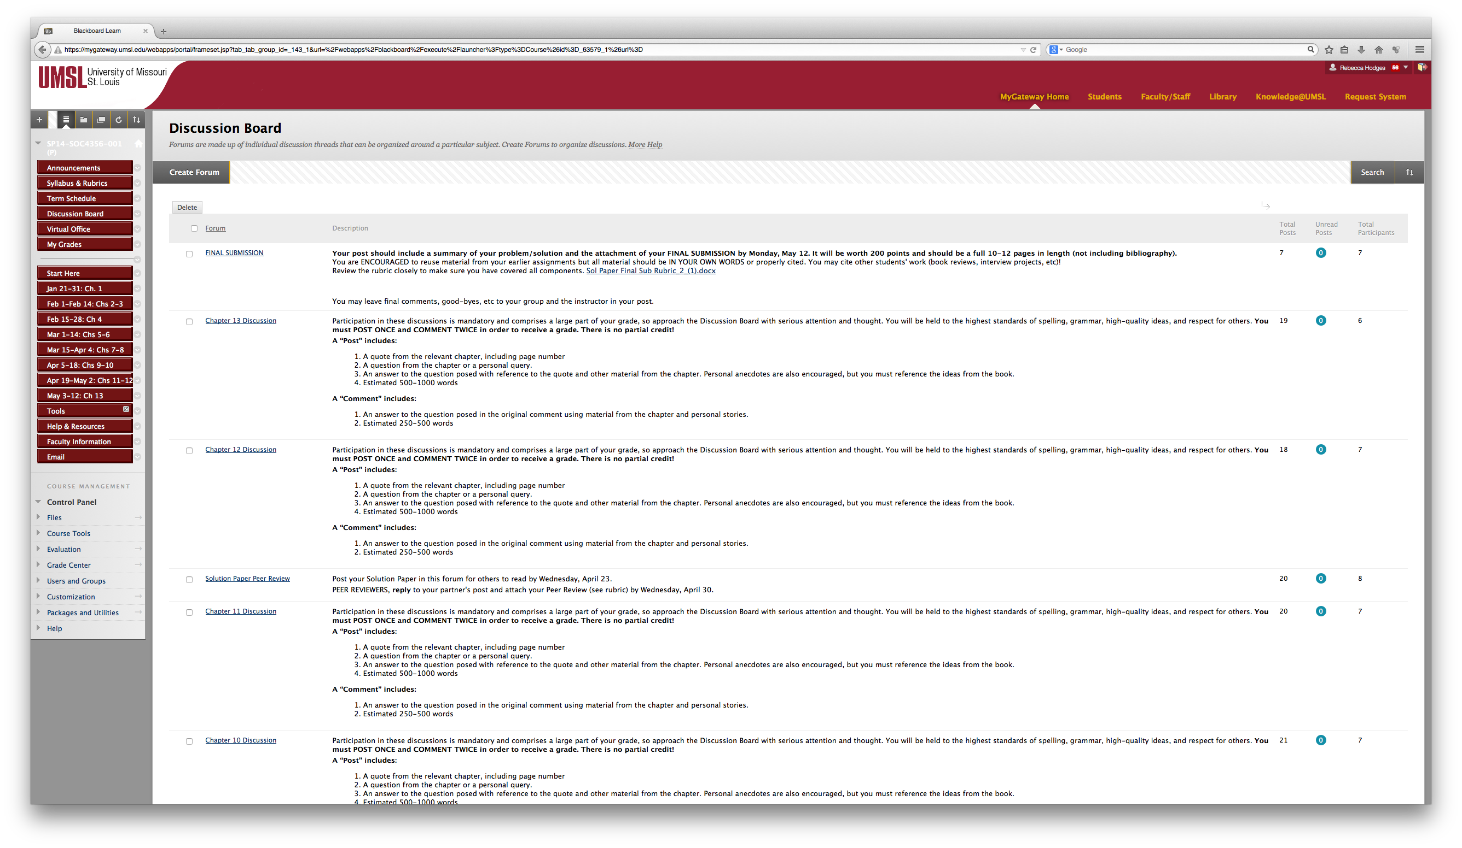

Slide 8
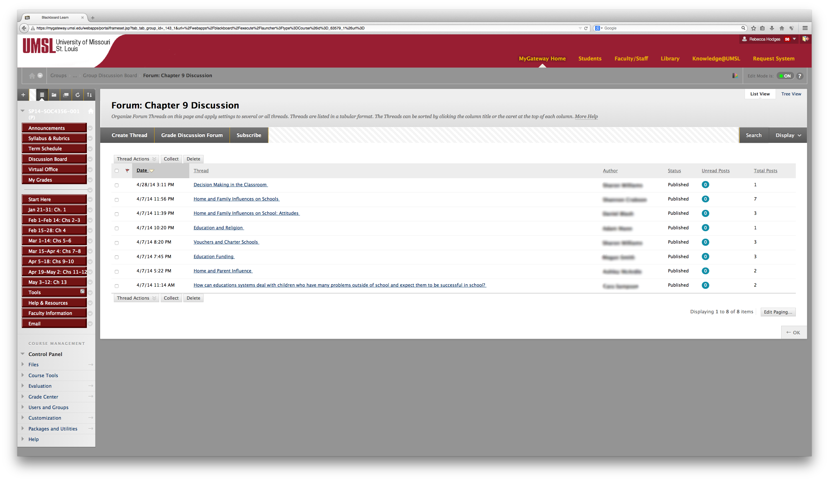

Slide 9
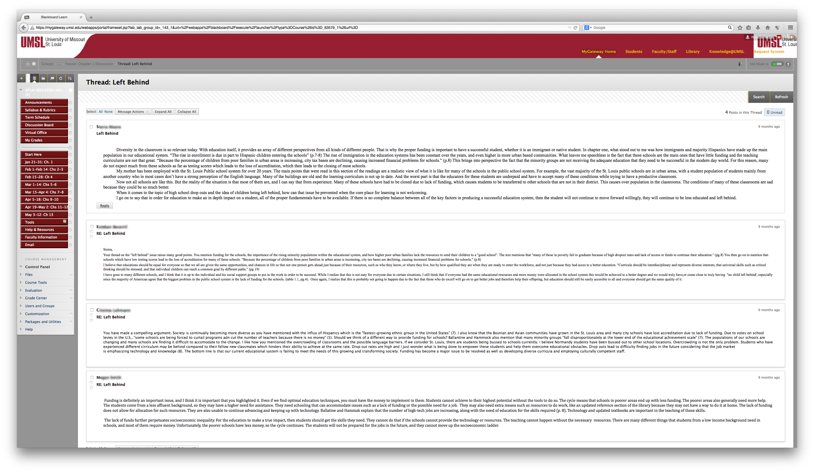

Slide 10
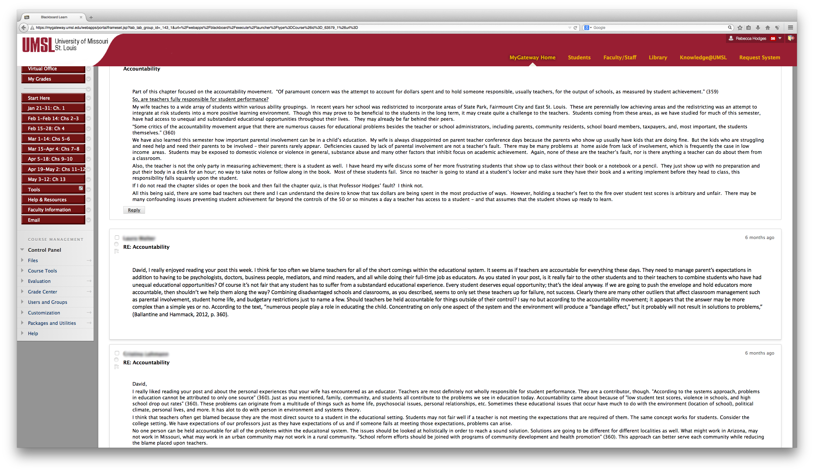

Slide 11
My question: Is Ability Grouping a successful technique for education or a method of holding certain children back?
“Mass education” was at one time provided so workers would learn how to be on time, be obedient and accountable for their actions. (Ballantine & Hammack, 2012, p. 61) This made them better employees and served the industries that profited from their work. Expectations of what an education should prepare an individual for have changed with time. However, most still believe that achieving an education improves one’s chances in life and for that reason a priority in the United States has been to expand opportunities for education. The hope for success and a bright future is still wrapped around the completion of a college degree for most of us. Chapter three begins with a discussion of how students are advised by a multitude of adults that staying in school is beneficial to their future. At the same time, there also exists a real issue of “all students not being able to take advantage of the potential schools present. “ (Ballantine & Hammack, 2012, p. 60) I found the term “potential school” a very interesting term and I found myself considering a potential school such as college and how a student gets there. I always believed (and still do) that an education is a key to success not only in a career but as an individual member of society. Knowledge is such an important thing to share! I took it for granted that anyone who worked hard and studied hard could achieve success and go on to college. Reading this chapter was very educational for me and I have become aware of my ignorance of the ways individuals are denied access to education and to a chance for completion of college.
Stratification, which refers to the position of one in “society’s hierarchy”, is a strong influence on a person’s life in the United States. (Ballantine & Hammack, 2012, p. 63) Although individuals are not legally ascribed into “castes” for life and there are true opportunities for advancement such as through education, there is not as much room for class advancement as people might like to think. Social class has implications throughout our society for individuals; it affects the opportunities they find, their health, family, and many other aspects of life. (Ballantine & Hammack, 2012, p. 64) It is true that higher educational achievement is a predictor of future success but it is also true that higher educational achievement is highly interrelated with social class and family income. Students of lower social class may have high ability but they still have a much lower chance of going to and completing college than students of higher social classes. (Ballantine & Hammack, 2012, p. 67) How could it be that children of lower social class can attend the same schools, show high ability and still not be able to attend college? If college is the key to future success and a way to improve one’s class/position in life, how is it these students are denied the opportunity of an education? Finances are a big obstacle to attending college. Federal student loans were created to assist students who want to attend college but lack the means. Obstacles to attending college however, appear far sooner than I ever thought about and for a child in the primary or secondary grades, paying for college is the least of their problems.
When a child enters school or very shortly thereafter, she may be “tracked” or grouped with children perceived to be of similar cognitive abilities. Cognitive abilities involve “conscious mental activities (such as thinking, understanding, learning, and remembering).” (Merrian-Webster Online Dictionary) Some argue grouping children with similar abilities is an effective way to teach children with similar needs. But how are children assigned to that ability group which they may occupy for the balance of their primary and secondary education? Research has shown at a very early age in their education, “cognitive differences are strongly associated with parental social status.” (Ballantine & Hammack, 2012, p. 76). “Ability” actually has less to do with grouping than the perceptions by the teachers, screeners and administration about where the child belongs. Lower ability groupings have been shown to include a “disproportionate number” of lower social class and minority students. This is an example of stratification and the results of this placement impact not only a child’s educational experience and success but also their ability to attend college and succeed in a career as an adult.
In a good educational system, wouldn’t children of all abilities be provided a solid education no matter their perceived cognitive ability? The short answer is no. Lower level classes are shown to receive less attention from teachers and are provided poorer instruction. Additionally, ability groups reinforce negative feelings and sense of separation for children and cause them to lower their aspirations. (Ballantine & Hammack, 2012, p. 81) The expectations and treatment of children by teachers has also been shown to be affected by ability grouping and can influence children’s self-image in a negative way. (Ballantine & Hammack, 2012, p. 83) There is benefit for children placed in gifted and higher tracks (who are disproportionately of higher socio-economic status), but there are few beneficial effects found for those in the lower groups. (Ballantine & Hammack, 2012, p. 81) A “heterogeneous” class of all levels of learners might be one start to addressing some of these issues. Although there are problems with this type of class as well (curriculum for wide ability range, less ability to cover high level topics) creative use of groups within the class and the fact that students are not stigmatized can augment the success and inclusion of all students. (Ballantine & Hammack, 2012, p. 81) I was fortunate to be placed in what was called “Honors” in school in which we had an advanced curriculum with a specific group of handpicked students who spent every class period together. My children have been in gifted and AP classes as well. It is difficult to see inequity when you are on the positive receiving end. This chapter really forced me to think about ability grouping, tracking and how it is used in a negative way.

Slide 12
Sample Comment:
I was thinking about the Normandy School District too when I was reading this chapter. You started me thinking as well about what “choice” really is and how it can bring chaos.
“Choice is a strategy for reform and restructuring.” (Ballantine & Hammack, 2012, p. 74) Choice for parents and students can create competition and in our society, competition is considered a positive force. In raising my children, I have seen choice play out both in the magnet schools in the city and also in the expansion of AP classes and higher level courses offered to students who are qualified academically and choose to participate.
Here is the other side of the coin, for every child who attends a magnet school or takes an AP class with a limited number of seats; a child is left in a substandard or at best mediocre school or class. The magnet school lottery system seems more fair on its face, but when you watch the joy on the parent’s faces when their child is chosen and then observe the tears of those who are left behind it is obvious something is wrong! Why does one have to suffer so that someone else can step ahead?
The text asked if school systems should be subjected to “individual choice and market forces.” (Ballantine & Hammack, 2012, p. 74) This is a very provocative and interesting question. Competition is a great thing if you are selling shoes or cars and a customer’s right to walk away or buy is a powerful thing. However, an education is a once in a lifetime opportunity and adding the “chaos” of choice might have the tipping power to harm students. If everyone opts out, then who is left in the failing school to succeed ? Do they have a chance at all? Will only the “least capable student” (Ballantine & Hammack, 2012, p. 75) be left or even worse, the students who do not have parents or other individuals in their lives advocating for them? It is the role of the educational system to assist each student in reaching success, and looking too much to outside players (like charter schools) is doing a disservice to students with the least outside resources.
You say: “I just believe that if I am allowed a “choice” to be educated to the fullest than I want to be given that chance.” You hit the nail on the head. Perhaps the focus should be on educating students to the fullest, perhaps a system where students attend schools near their homes but resources are shared equally statewide and standards of maintenance and safety for schools are enforced fairly. I am not sure it is possible, given state politics in Missouri, but isn’t it worth a try?

Slide 13
Term Writing
“In this course, you will be focused on solving a major problem in educational systems or practices. The largest part of your grade will come from papers you will submit both to the instructor and to the thematic group of which you are a member. All of the writing projects are intended to tie together including chapter quizzes from your textbook, reviewing another book, and interviewing people involved with education in order to come up with innovative solutions to one of the largest problems in contemporary education.”
All writing assignments were posted in the Discussion Board and available to all students in the thematic group. Students were encouraged to read each other’s work and use any material helpful for their solutions in their term papers (with proper attribution).
Book Review
Interview Project
First Draft
Peer Review
Final Draft

