Slide 1
The Missouri Model: What Works for Juvenile Corrections
Beth M. Huebner
University of Missouri – St. Louis

Slide 2
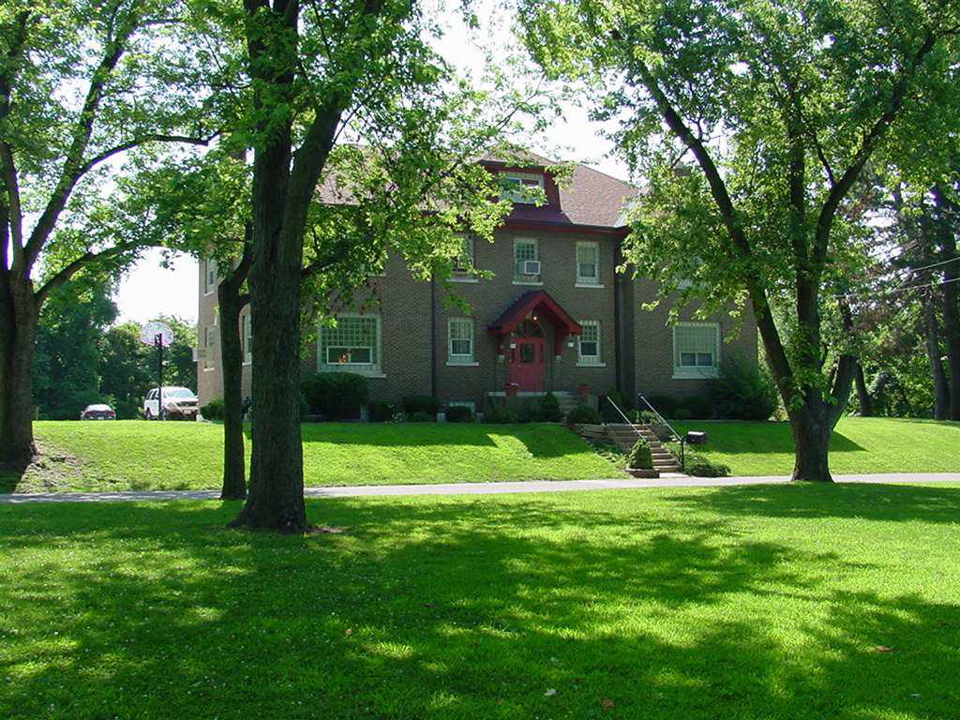
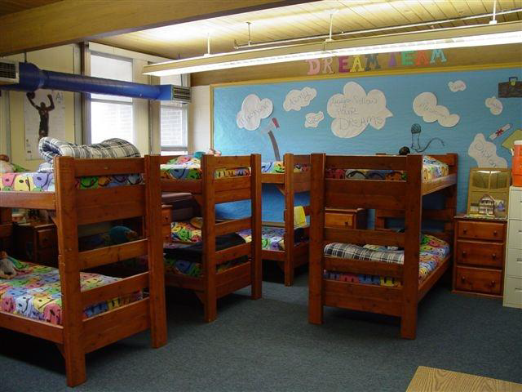
Changing the Destination in Missouri Juvenile Corrections
Starting with a different place to find a new destination
Source: Missouri DYS

Slide 3
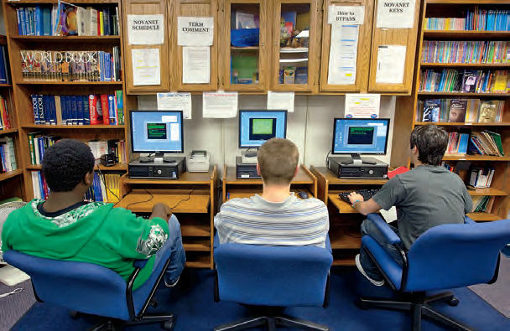
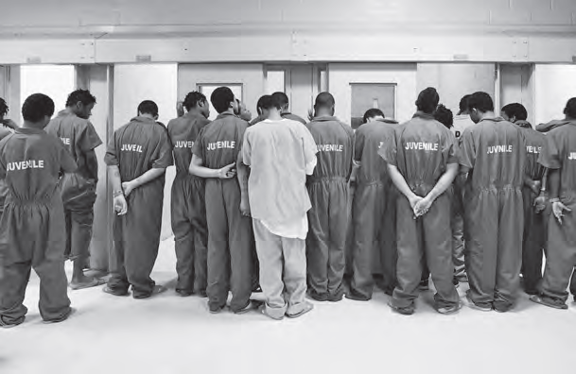
Source: Annie E. Casey Foundation

Slide 4
History of Juvenile Corrections in Missouri

Slide 5
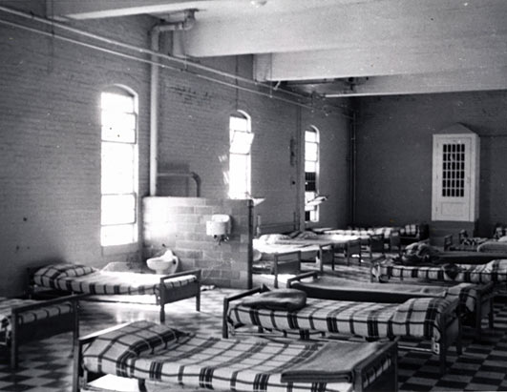
Boonville Correctional Center for Boys

Slide 6
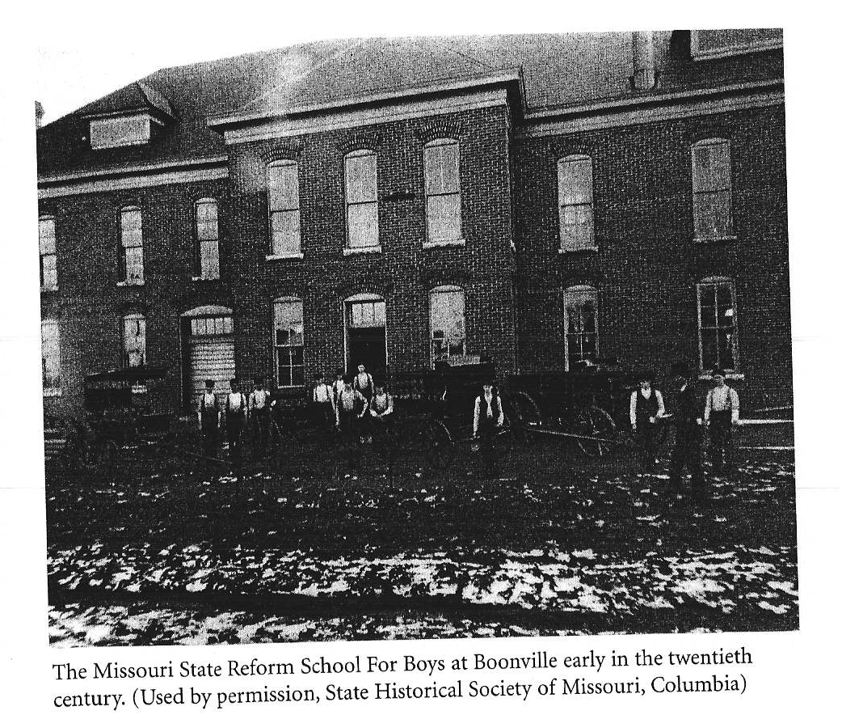
Missouri State Reform School for Boys

Slide 7
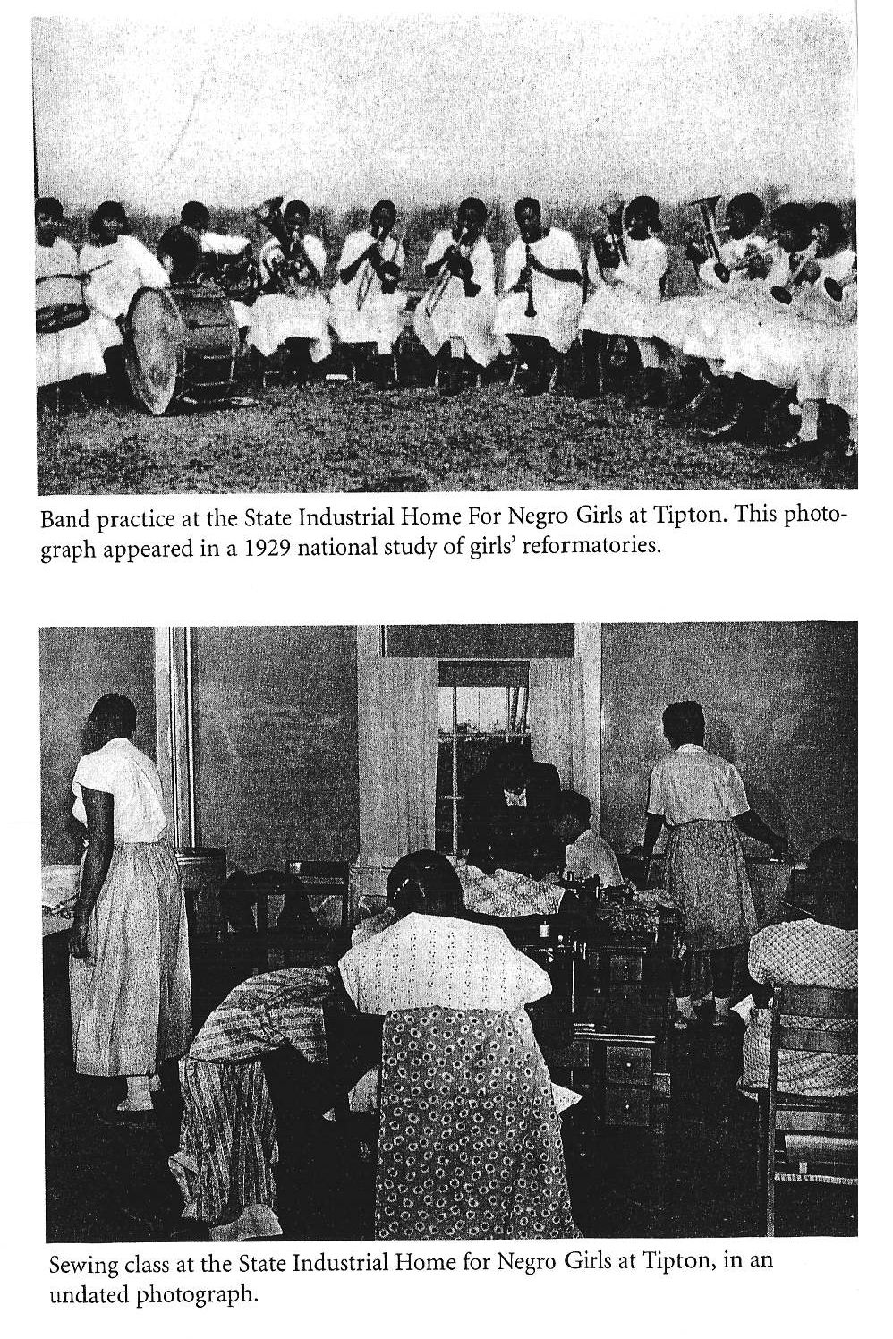
Segregation in Juvenile Placement

Slide 8
Historical Progression of Juvenile Corrections in Missouri
1957. Unified Juvenile Court Act. W.E. Sears Youth Center in Popular Bluff was approved.
1975. US District Court Western District of Missouri filed consent decree over conditions at Boonville.
1983. All large, congregate juvenile facilities are closed. Dorm style cottages are built.
1987. Youth Services Advisory Board. Budget increased from $15 million to $60 million.
2005. Office of State Court Administration – Juvenile and Family Court Division

Slide 9
Juvenile Corrections System In Missouri
Department of Youth Services
  Centralized system – 5 regional offices
  45 juvenile courts
  32 residential facilities (726 total beds)
Indeterminate sentencing
17 age of adulthood in Missouri
Average per diem cost is $167.30 (annual $61,064)

Slide 10
Juveniles under Secure Care
649,000 children aged 10-17
16,500 court contact
6,400 children's division
10,000 community or informal sanction
2010 – 2,111 in DYS secure care

Slide 11
Population Under Supervision
Demographic Characteristics
  Predominately Male Population (86% Male; 14% Female)
  Average age 15
  37% are of minority race
  66% from metro areas
    29% from St. Louis
Incarcerated Offense
  11% serious personal felonies (robbery, assault)
  42% non-personal felonies (drug & property offenses)
  37% misdemeanors
  10% juvenile offenses
Social and Educational Needs
  Youth have an average of 9 years of schooling
    34% diagnosed educational disability
  38% with an active mental health diagnosis
  58% substance abuse history

Slide 12
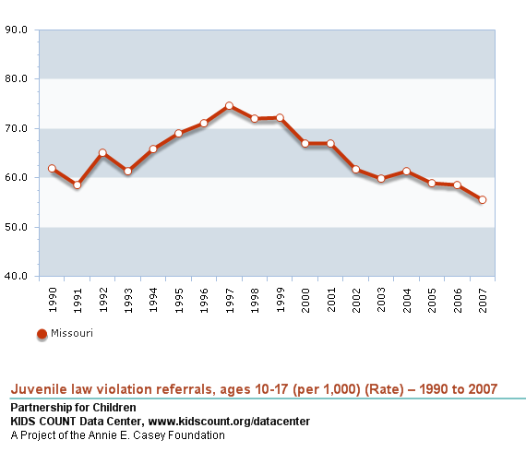

Slide 13
The Missouri Model

Slide 14
“What Works” in Juvenile Corrections
Therapeutic Services
Key Intervention Points – Lipsey and Colleagues
  Therapeutic control is more effective
  Incarceration and deterrence based programs have little influence on recidivism.
Elements of the Missouri Therapeutic Model
  Restorative, small communities.
    1:6 staff ratio
    Small group interactions (10-12 individuals per group)
    Youth are placed within a 75 mile radius of their home
  Active Supervision
    Smaller, less crowded institutions are more likely to emphasize rehabilitation.

Slide 15
“What Works”: Needs Based Assessment
Focus on high risk offenders.
    Comprehensive case management
    Sophisticated risk assessment tools
RNR Model
  Risk - Match the level of service to the offender's risk to re-offend.
  Need - Assess criminogenic needs and target them in treatment.
  Responsivity – Tailor treatment and intervention to the learning style, motivation, abilities, and strengths of the offender.

Slide 16
Diversion – Managing the institutional Population
Approximately $4 million of the total DYS budget is allotted to courts for diversion programs.
GOAL: Increase therapeutic programming while maintaining ties to the community.
  In 2010, 7,291 were referred to diversion
  Only 6% were eventually sent to institutional care
Annie E. Casey Juvenile Detention Initiatives Program.
  Rate of juvenile detention: 246 per 100,000

Slide 17
Effective Treatment – “What Works”
Positive treatment centered environment.
  Cognitive behavioral programming
  Behavioral Interventions
  Education
  Social Skills
No one central program model
All services are provided by DYS staff. No outside contractors.
  Increased the educational requirements of staff.
  Enhanced, annual training.
  Individual treatment plans vs. flavor of the month

Slide 18
Counseling, Accountability, and Leadership
Peer Centered Treatment Model
Assumption: Successful programs must address cultural values of youth, school and peer relationships, and extended family and work.
  Change does not occur in isolation
Therapeutic setting with goals and accountability.
  Extends the duration and intensity of the treatment model.
  Very similar programmatic model to the Therapeutic Community program used with adult corrections.

Slide 19
Education – A central Domain of Delinquency and Resilience
DYS is an accredited school district, and all youth have 6 hours of schooling a day.
The DYS has 150 teachers and 42 educational programs.
You can continue in the educational system until graduation.
  A central component of the continuum of care.
  All educators are part of the DYS treatment team.

Slide 20
“What Works”: Aftercare Model
Individuals are at greatest risk immediately following release.
Comprehensive case management
  Maintain supervision by case specialist and DYS caseworker.
Wrap Around Services
Community Services
  Community mentors
Division of Workforce Development
  Job placement and sharing program.

Slide 21
Evaluations, Outcomes & New Directions

Slide 22
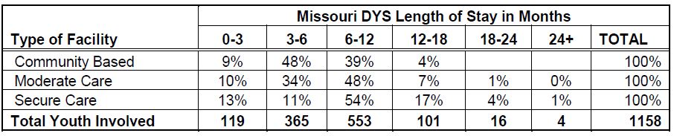
Outcome Assessment – General Conclusions
Critical Elements of a Successful Intervention
Intensity
  Clients need frequent contact – particularly at the beginning of release.
Duration
  Programs longer than 90 days are most successful.
Fidelity
  Do what you say you are going to do – all the time – with each individual.

Slide 23
Three Year Recidivism Outcomes
Source: Annie E. Casey Foundation

Slide 24
State Comparisons
Source: Annie E. Casey Foundation

Slide 25
Reported Outcomes by DYS Staff
Enhanced Institutional Environment
Enhanced Institutional Environment
Safety Outcomes: Missouri vs. Ohio
(INCIDENTS PER 1,000 CUSTODY DAYS—2005)
  Source: Research by Dick Mendel (2008) comparing Missouri DYS to youth correctional programs participating in the Performance Based Standards (PbS) process. Annie E. Casey Report
 | Ohio | Missouri | Ratio
Mechanical Restraints | .69 | .28 | 2.5:1
Isolation | 1.07 | .04 | 245:1
Physical Damage or Theft | .21 | .02 | 9.5:1

Slide 26
Educational Outcomes
One Year of Educational Progress Made
Missouri | 75%
National Average | 25%
  95% of youth in DYS earned high school credits.
  30% go on to complete GED or obtain high school diploma.
  The educational completion rate has doubled since gaining accreditation as a school district.
Source: Annie E. Casey Foundation & Division of Youth Services

Slide 27
Challenges to Evaluation
Data were not based on common reporting criteria.
  What is recidivism?
  Recidivism data can be influences by agency-level policy decisions.
Size and nature of juvenile sample varies by state
  Missouri data end at age 17.
  Outcome measures do not include rearrest.
  Little is know about other correlates of failure.

Slide 28
Future Steps in Evaluation
Process Evaluation
  Why and How does the program work?
  Correctional Program Checklist (Lowenkamp & Latessa)
  Evaluation Protocol for Assessing Juvenile Justice Programs (SPEP) - Lipsey
Replication
  Program model currently being implemented in District of Columbia, Louisiana, New Mexico, and Santa Clara County.

Slide 29
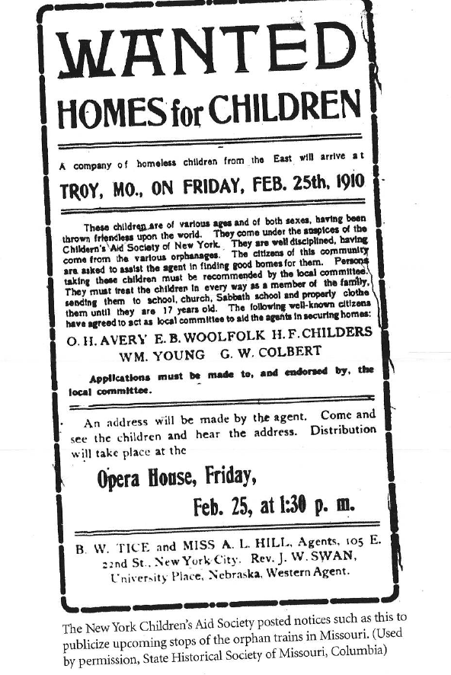
Evaluation – Next Steps
Document the total juvenile justice population.
Compared to What?
  Survey of Youth in Residential Placement
Does the program encourage
  net widening?
What is the role of race and ethnicity in decisions?
Desistance – Why do people
  stop

Slide 30
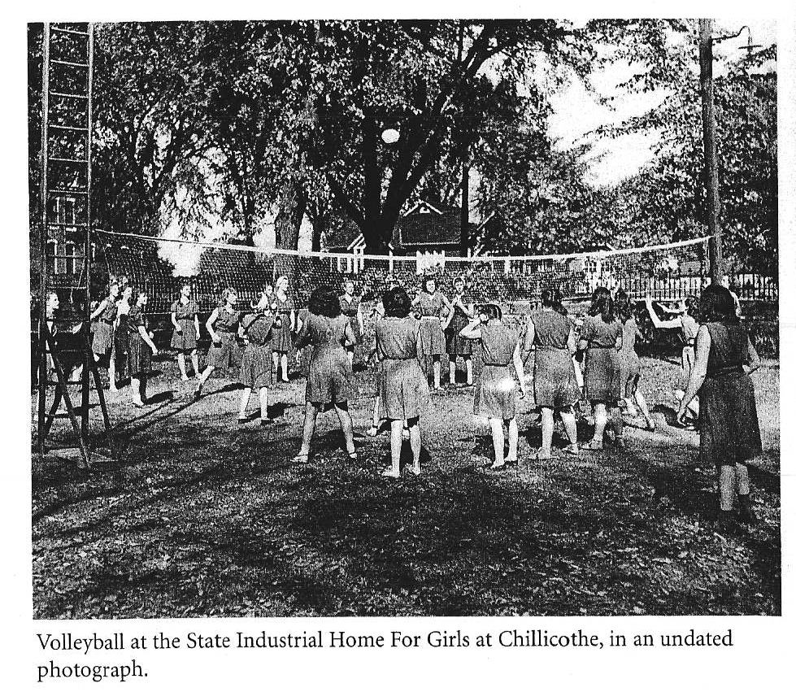
What Works for Whom– Unique Need of Girls

Slide 31
Girls in the Juvenile Justice System
Girls represent 15.7% of commitments
  More likely to be serving time for misdemeanors (44%) and juvenile offenses (22%)
  56% of men serving time for felonies
Unique gendered pathways to delinquency
  Histories of sexual abuse
  Teen pregnancy
  Challenges with substance abuse

Slide 32
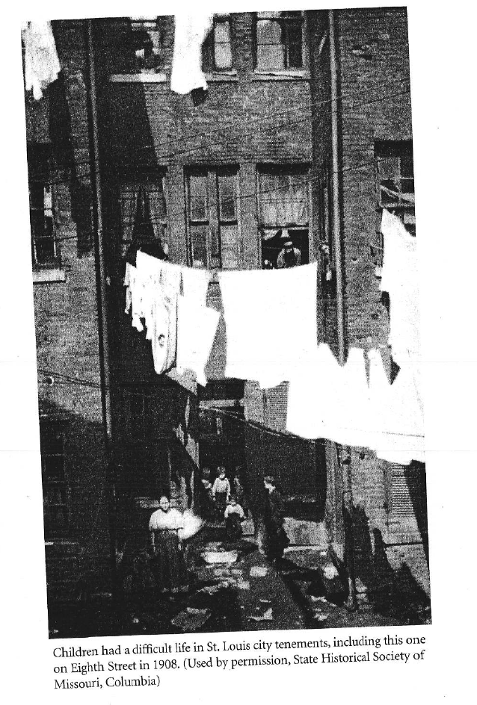
Urban Poverty and Juvenile Delinquency

Slide 33
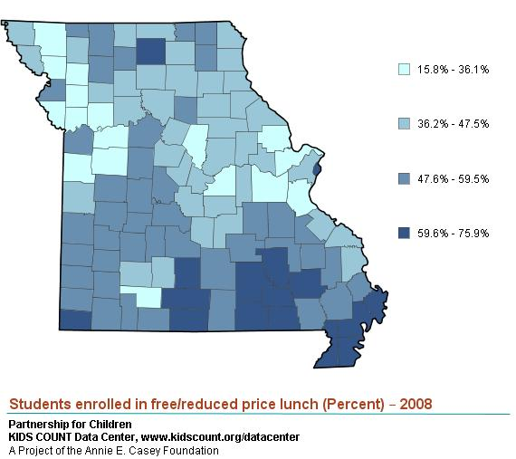
Challenges of Youth in Rural Areas
Fiscal challenges have cut services.
  Difficulty maintaining treatment services to youth in more remote areas.
Specific challenges
  Rural poverty
  Seasonal workforce in rural areas
  Smaller housing stock

Slide 34
Resources
The Missouri Model – DYS maintained site
  http://www.missouriapproach.org/
Missouri Model program consulting agency
  www.mysiconsulting.org
What works for juvenile offenders – Lipsey and colleagues summary document
  http://cjjr.georgetown.edu/pdfs/ebp/ebppaper.pdf
Annie E. Casey Evaluation
  http://www.aecf.org/~/media/Pubs/Initiatives/Juvenile%20Detention%20Alternatives%20Initiative/MOModel/MO_Fullreport_webfinal.pdf
Innovations Video
  http://www.youtube.com/watch?v=7rNo1KDZnuo

