Slide 1
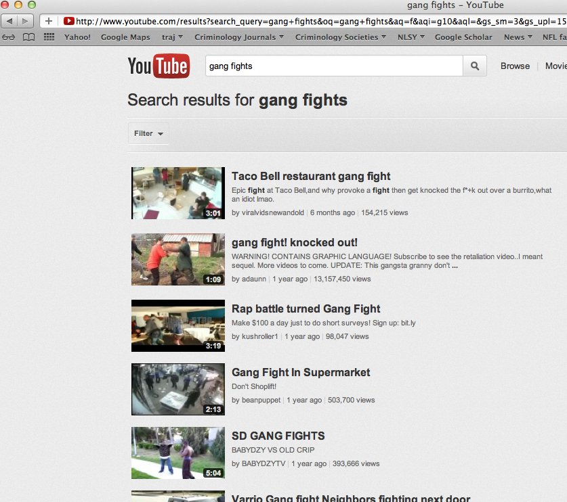
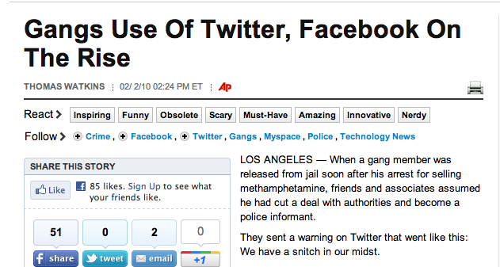

The Criminal and Routine Activities of Gang Members Online
Scott Decker
Scott.Decker@asu.edu
SCHOOL OF CRIMINOLOGY
AND CRIMINAL JUSTICE
Notes:
Technology is agnostic—the internet, facebook, and twitter and related social mediums do not take positions on issues with the exception that people should be able to freely communicate.
Technological advances over the last decade have corresponded with growing concerns that social networking and related sites are being exploited by criminal and deviant subcultures.
I am presenting data from an exploratory study into how gangs and gang members use the internet for criminal and non-criminal purposes.

Slide 2
The Internet and American Life
Internet is increasingly integrated into everyday life (Tyler, 2002)
  Paying bills, voting, shopping, information seeking, applying for jobs, etc.
Internet use helps to facilitate social connectedness, capital, and integration (Pasek, More, and Romer 2008; Wellman, Haase, Witte, and Hampton 2001)

Slide 3
The Digital Divide
75% of Americans use the internet (Zhang, Callegaro, and Thomas, 2008)
Focus on access to internet and what people do online (Barzilai-Nahon 2006; DiMaggio, Hargittai, Neuman, and Robinson 2001)
Digital resources are not distributed evenly across society (Stern, 2010)

Slide 4
Marginalization from the Internet
The poor, the elderly, and minorities are least likely to access the internet
  Lower frequency of home computer ownership, infrequently access the internet at school (Rector and Sheffield 2012; Servon and Nelson 2001)
Minimal research focuses on these and other marginalized populations, such as gang members

Slide 5
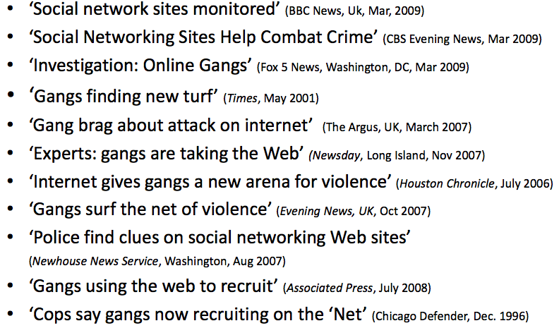
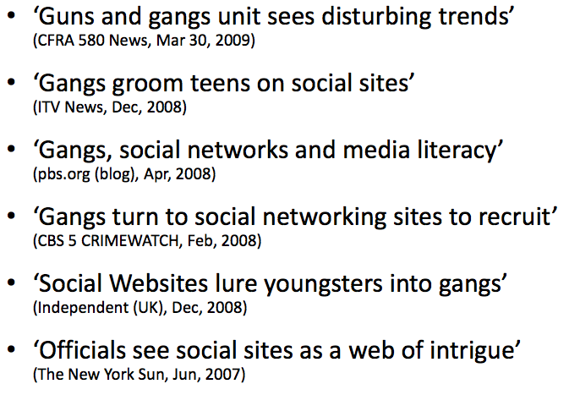
Headlines
Przemieniecki, Chris J. and Mario L. Hesse. Aug 2009. “Are Your Kids Cyber-Chatting With Gangs?” National Gang Crime Research Center, 12th International Gang Specialist Training Conference, Chicago, IL.
(adapted with permission)
Notes:
The criminal justice community is very concerned about gangs on the internet. That concern surrounds:
The recruitment of youth,
the supposed organizational structure of gangs
Illegal behaviors being transferred to online settings.
From 1996 forward, the police have been saying that gangs are increasingly using the internet for criminal purposes.

Slide 6
National Gang Threat Assessment
FBI 2011
    “Gang members routinely utilize the Internet to communicate with one another, recruit, promote their gang, intimidate rivals and police, conduct gang business, showcase illegal exploits, and facilitate criminal activity such as drug trafficking, extortion, identity theft, money laundering, and prostitution . . . computer hacking, and phishing schemes”
    “Social networking, microblogging, and video sharing websites—such as Facebook, YouTube, and Twitter—are now more accessible, versatile, and allow tens of thousands of gang members to easily communicate, recruit, and form new gang alliances nationwide and worldwide.”
    Really?
http://www.fbi.gov/stats-services/publications/2011-national-gang-threat-assessment
    *These estimates were derived from the large number of gang members populating social networking Web sites such as Hoodup.com, Facebook, and MySpace
Notes:
The recent FBI NGTA, though, seem to have some pretty good information on gangs online, providing this definitive statement.
Footnote says . . .
We are skeptical, however, about several of the National Gang Intelligence Center’s (NGIC) conclusion.

Slide 7
Evidence of Gangs Online
Content analyses of SNS pages/posts (FB, MySpace, Twitter et al.)
  Knox (2011):
    law enforcement benefits from the information, but gangs intimidate citizens and corrupt the internet community
  Morselli and Décary-Hétu (2012):
    individualized activities rather than coordinated behaviors
  Womer and Bunker (2010):
    SoCal Hispanic gang and drug cartels promoted their activities using social networks
Self-reported information
  King et al. (2007):
    i-Safe 2006 survey (over 100,000 students, 137 gang members)
    25% of gang members used the Internet 4 hours per week
    45% of gang members gained access to the Internet at community centers
Notes:
Two types of studies have provided evidence on the extent and nature of gangs online.
Content analyses examine the individual and group pages of gangs and gang members in search of gang-related information. The two articles using this method have reached divergent opinions on this issue.
The Morselli and Decary article found very little evidence of collective gang behaviors. They rested on a social network framework to argue that, even more online than on the street, gang members perform as individual actors rather than group members.
The Knox article argued that gangs are a menace for the internet, falsely claiming they are community organizations or religious groups; that they intimidate citizens, and that they corrupt the internet; however, the police benefit.
Survey research, alternatively, asks gang members about their behaviors.
King et al. reported what is, to our knowledge, the only study of gang members in online settings in a commentary that can be found in the Journal of Adolescent Health.
Content analyses are limited because gangs and gang members only disclose so much information online. Survey research is limited due to the absence of studies and issues associated with the sample design in the King et al. study.

Slide 8
The Routine Activities of
Non-Gang, Gang, and Ex-Gang Respondents in Online Settings
Notes:
This study was motivated by
(1) the fact that social lives are lived increasingly online and the narrowing of the digital divide,
(2) the concern that groups are hijacking the internet for deviant purposes.
We decided to go out and ask gang members if they use the internet, and if so, what they do online.
I am presenting several slides onthe basic descriptive statistics from this exploratory study.

Slide 9
Sample of Those “Beyond” the Digital Divide
585 individuals drawn from five US cities (Cleveland, St. Louis, Phoenix, Fresno, and Los Angeles)
Probation and parole, outreach agencies, and jail populations
Urban residents, predominantly minority, limited education, limited income, state support, criminal histories

Slide 10
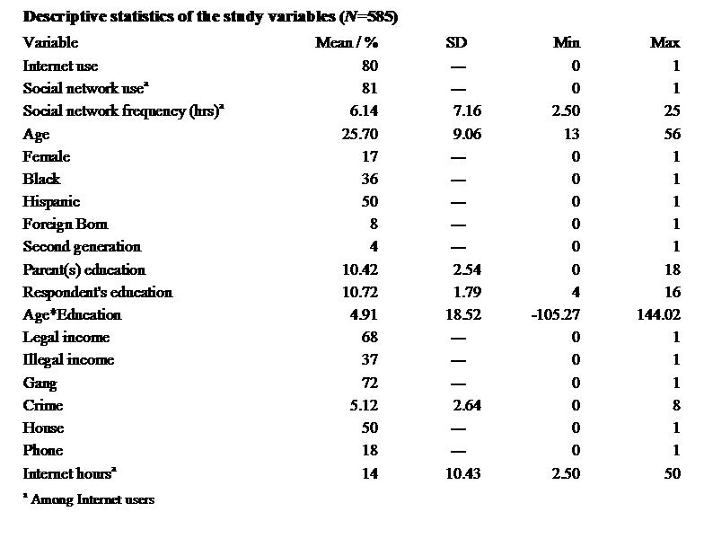
Descriptive Statistics

Slide 11
Are Gang Members Online?
N=167 N=188 N=230 N=585
*no statistical differences observed
Notes:
Yes. They are.
In light of Rick’s presentation, their prevalence of Internet use is comparable to the US population as a whole
Main point: 80% of gang members use the Internet.

Slide 12
How Much Time is Spent Online?
N=135 N=147 N=181 N=463
Notes:
On average, the sample spends about 6 hrs per week online for personal reasons. Adjusting for age makes very little difference.
Former gang members tend to spend more time online, which we believe is attributable to be more immersed in conventional society of free from the constraints of the group (i.e., searching for jobs).

Slide 13
Do gang members have computer skills?
3. Fix problems, use Linux
2. Fix most computer problems
1. Surf the web, use basic software
0. I am afraid of computers
Holt & Bossler (2009)
(M=1.13) (M=1.05) (M=1.20) * (M=1.13)
N=167 N=188 N=230 N=585
Notes:
If gang members are using the internet for identity theft, computer hacking and phishing schemes, we would suspect that they would exhibit some degree of computer skills.
We drew from Holt and Bossler’s Deviant Behaviors piece to learn whether, and asked if they were 0) afraid, 1) surf the web, 2) fix problems, 3) use linux.
We ound that, as a whole, most do not report being technologically savvy, with the modal category being 1.
Main point: Most gang members don’t have the technological capacity to carry out serious cybercrimes.

Slide 14
What do gang members do online?
N=135 N=147 N=181
Among internet users
*no statistical differences observed
Notes:
For the most part, they do what regular people do:
they shop at a rate that is not inconsistent with the general public (around 30%),
they watch youtube videos at a high rate (around 85%),
and they use social networks at a rate of 80%.
Main point: nothing is overwhelmingly alarming with these figures. They do what normal people do.

Slide 15
Social Network Usage
Never use
Infrequent use
Frequent use
Non-gang
Current Gang
Former Gang
N=167 N=188 N=230
Notes:
We concentrated more on social network usage because there is the greatest concern about recruitment, intimidation, and internet contamination.
We partitioned the sample by self-reported non-users, infrequent users, and frequent users:
Non-gang respondents were more likely to report frequent use.
Main point: Facebook is the social network of choice, with the remainder used very infrequently.
It’s worth noting that when we started this project in early 2011, there was no such thing as Google+; they now have 100 million users. Goes to show how quickly social media advances.

Slide 16
Criminal and Deviant Activities
of Non-Gang, Gang, and
Ex-Gang
Respondents in Online Settings
Notes:
The results of the routine activities of gang members didn’t produce anything “special” that might be of concern. A lot of these findings could be due to selection induced by our purposive sampling strategy.
We now concentrate on criminal and deviant activities where, at least in the street setting, gang membership affects crime over and above selection. Further, this is of the greatest concern to the criminal justice community.

Slide 17
Have you done this?
Last 6-Mos | Lifetime
26% | 46%
4% | 7%
4% | 7%
10% | 19%
5% | 9%
2% | 5%
7% | 16%
8% | 19%
Illegally downloaded media or computer software?
Sell stolen products on sites like ebay? craigslist?
Set up a drug deal online (as a buyer or seller)?
Harassed or threatened someone on comment forums, social networking, blogs, or chatroom sites?
Planned to attack someone online? (via email, sns sites)?
Search social networking sites to steal from or rob people?
Posted videos of fights or threats on sites like Youtube?
Have you targeted or attacked someone in the street because of things that have happened online?
Notes:
We asked our sample a series of questions about activities they have engaged in online.
Some included:
actual crimes----downloads, conspiracy,
deviance----posted fights on youtube),
virtual events that prompt physical altercations.

Slide 18
By Gang Status: 6 months? Ever?
Non-Gang
Current
Former
47% Non
48% Current
44% Former
14%
20%
13%
12%
26%
18%
1.Illegal downloads*
7.Post videos*
8.Online → street*
N=463
Among Internet users
Notes:
We break up the first four forms of self-reported online deviance by gang status, with non-gang (yellow), current (red), and former (blue).
Statistical differences:
Downloads EVER: none
Downloads 6MOS: Current>non, Current>former
Stolen prod EVER: none
Stolen prod 6MOS: none
Drug deal EVER: none
Drug deal 6MOS: none
Threats EVER: none
Threats 6MOS: none
Main point: There’s not considerable variability across groups

Slide 19
Gang Activity Online
1.Search for gang info?
2.Watch gang videos?
3.Gang has a site?
4.Gang organizes online?
5.Gang post videos?
6.Gang recruits online?
N=417
7.Internet important to your gang?
8.Internet important to other gangs?
N=309
Notes:
We asked specific questions about gang-related activities. This speaks to larger questions about whether gangs are even capable to organize activities online.
Reiterate key findings.
How important is the internet?
Consistent with myths about gangs that Marcus Felson and Buddy Howell discussed.
Gangs are about promotion. If we are going to call them organized, we could say that they are great marketers capable of branding their name.

Slide 20
Findings
Do marginalized youth and young adults use the Internet?
80 percent of the sample use the internet.
  Similar to the 71 percent of the general population (71%, NTOI 2011), teenagers (93%,Jones and Fox 2009), college students (86 percent, Jones 2002)
  Average 14 hours per week online

Slide 21
Findings cont’d
2. Do marginalized youth and young adults take advantage of social media produced by Web 2.0?
Yes. 80 percent of internet users in the sample are on social networking sites
  Similar to college students (88%, Hargittai 2008)

Slide 22
Findings cont’d
3. What factors explain rates and patterns of Internet and social network usage?
Internet: age, illegal income (-); female, education, legal income (+)
Social network: age, education (-); female, parent’s education, hours spent online, home access, phone access (+)

Slide 23
Discussion
The Internet appeals to the symbolic needs of gangs
The internet as an extension of the street
Gangs do not capitalize on the online possibilities at the group-level
Gang members largely lack the technological capacity to carry out complex cyber-crimes
Notes:
Internet appeals to the symbolic needs of gangs
So much of what gangs do on the street is symbolic—self-promotion, posing, bragging, posturing.
There is no reason to believe that this wouldn’t extend to the virtual world.
The internet is an extension of the street.
The online rumor mill is very active and accessible; thus, word travels fast and is visible. As a result, there are real consequences to virtual activities.
Gangs do not capitalize on online possibilities at the group-level
Gangs are not very organized on the street, so why would we expect them to be organized online. They do not recruit online, they do not structure drug deals, they do not organize activities; this is unlike the private and public sectors that structure everything online.
What the Internet does is provoke group process, but is does not elicit group structure.
Gang members lack the technological capacity to carry out cyber crimes.
However, as technology becomes more simplified and constructed for the masses, accessibility and opportunity may restructure the convergent elements of criminal and gang behavior to warrant a renewed focus on the criminal activities of gang members online.

Slide 24
Conclusions and Policy Considerations
Most marginalized individuals appear to use the internet, and a substantial portion participate in social networking
Promoting technological literacy among criminal justice involved individuals worthwhile
  Assist probationers and parolees in locating work – Linkedin, Monster, etc.
  Resources for leaving gangs

Slide 25
Policy and Programmatic Considerations
Monitoring/Surveillance
Risk Group Identification
Risk Factor Identification
Mentoring

