Slide 1



The University of Missouri-St. Louis
Science Education Programs
S T A R S
STUDENTS and TEACHERS
AS
RESEARCH SCIENTISTS

Slide 2
The University of Missouri-St. Louis
Science Education Programs
S T A R S
Partnership of Universities Scholar Research Program

Slide 3
S T A R S
2010 Sponsors
Pfizer, Inc.
LMI Aerospace Inc./D3 Technologies
Solae LLC
Academy of Science – St. Louis
Donald Danforth Plant Science Center
Saint Louis University
Washington University
University of Missouri - St. Louis

Slide 4
S T A R S
STARS offers academically-talented students who are entering their junior or senior years of high school and their teachers a rare opportunity to work within a laboratory research setting with top scientists.

Slide 5
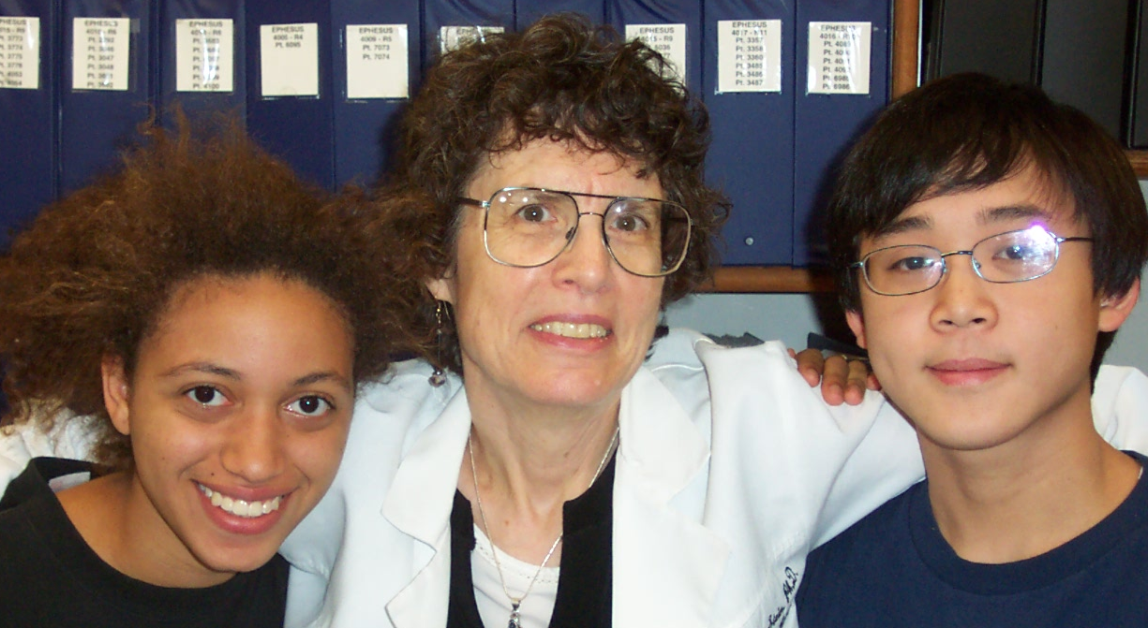
S T A R S
For six weeks during the summer, participants join a community of investigators working under the supervision of a practicing scientist.

Slide 6
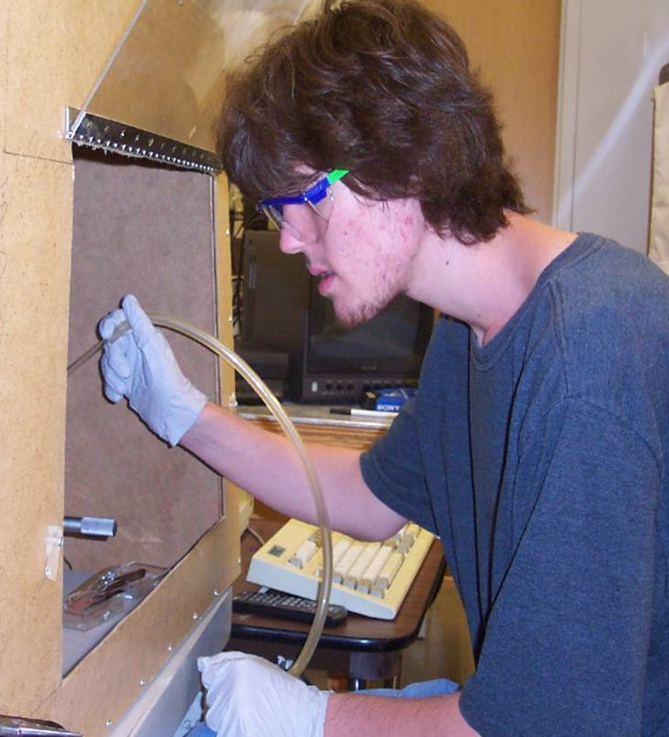
S T A R S
STARS participants spend an average of 30 hours each week for six weeks in a professional research environment – at the research bench, in the lab, in the field, or in a computer facility.

Slide 7
S T A R S
Another ten hours are devoted to activities that include:
Stimulating presentations by leading
researchers
Orientation by the participating
universities
Career discussions with practitioners
Instruction on how to prepare and
present a research paper

Slide 8
S T A R S
More than 60 scientists who work in fields such as biology, chemistry, computer science, earth science, engineering, environmental science, mathematics, medicine, optometry, physics, and psychology share their expertise as they and their research teams direct students and teachers in research projects.

Slide 9
S T A R S
Research sites include Donald Danforth Plant Science Center, Saint Louis University, St. Louis College of Pharmacy, Solae LLC, Washington University, and the host institution, University of Missouri-St. Louis.

Slide 10
STARS
EDUCATIONAL PHILOSOPHY
The student must experience the scientific enterprise in its totality under the leadership and modeling of experienced and successful research mentors in order to develop a functional understanding of science and to gain a facility for the processes of inquiry and discovery.

Slide 11
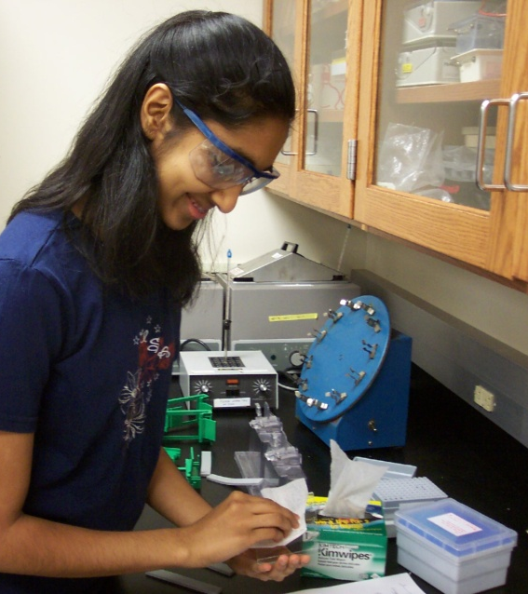
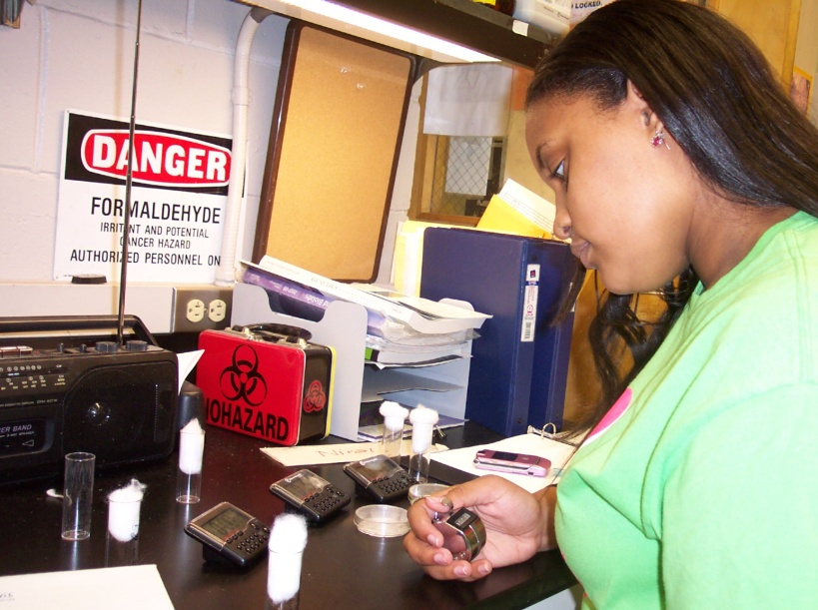
STARS
MISSION STATEMENT
The mission of the STARS program is to enhance the understanding and augment the application of the philosophy and processes of science and mathematics for students through expertly guided, real-life experiences in inquiry and discovery and therefore, facilitate and enhance the number of students selecting STEM degree programs and careers.

Slide 12
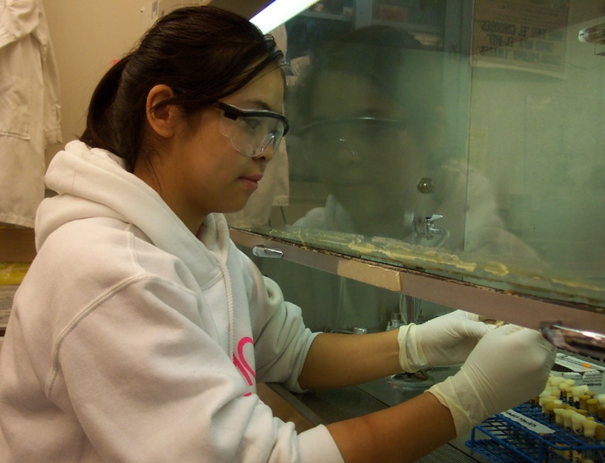
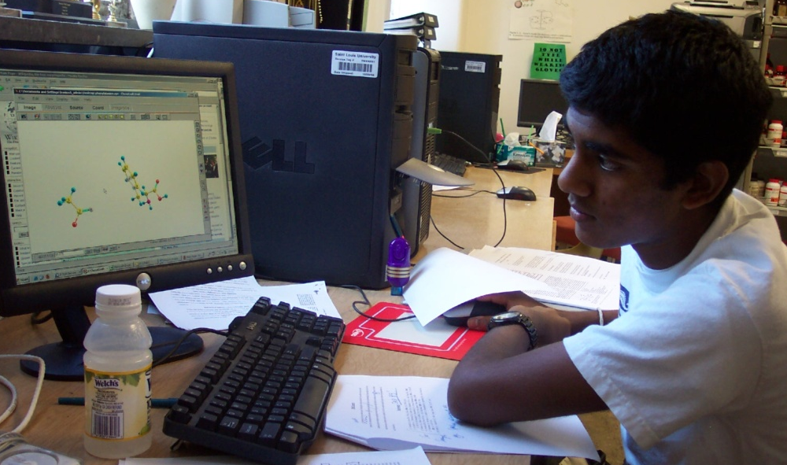
STARS GOALS
Foster in students an understanding of the philosophy, nature, and ethics of science and the dynamics of the scientific enterprise, including the methodology, aims, and the nature of the scientist;
Enhance content knowledge of current topics in mathematics, science, and related fields;

Slide 13
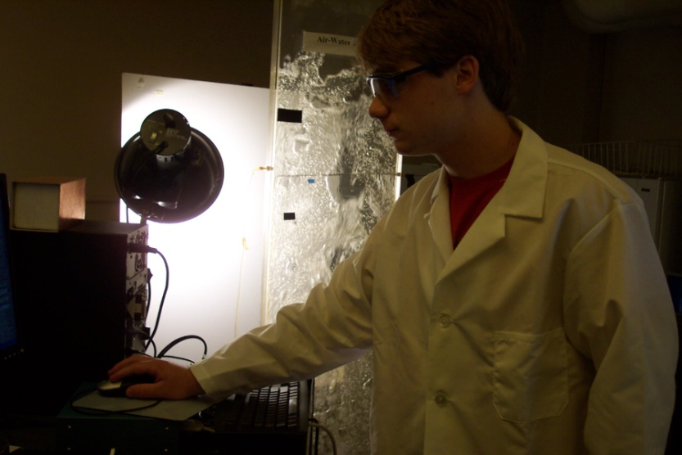
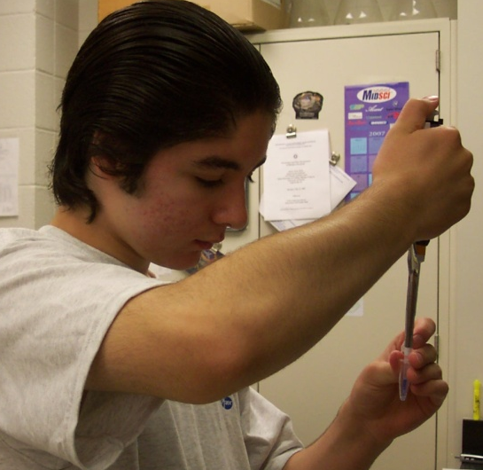
STARS GOALS
Provide experiences in scientific research design, experimentation and evaluation through the explorations of one or more scientific problems;
Instruct participants in technical writing and oral presentation of scientific papers;
Increase knowledge of the variety of career opportunities in science and technology and the breadth and depth of their applications in the workplace;

Slide 14
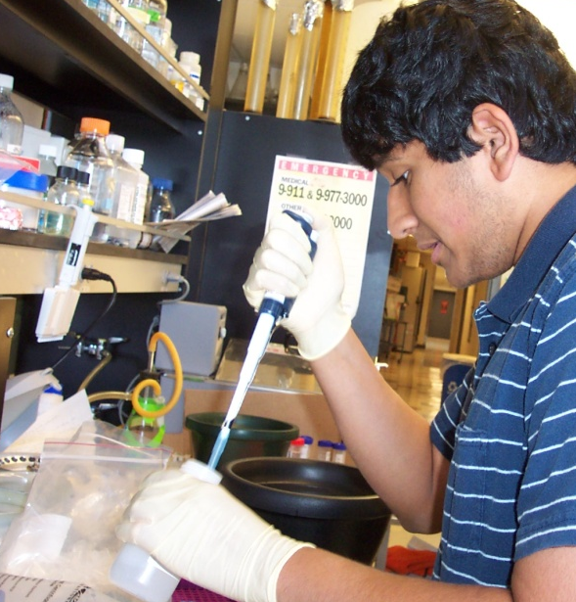
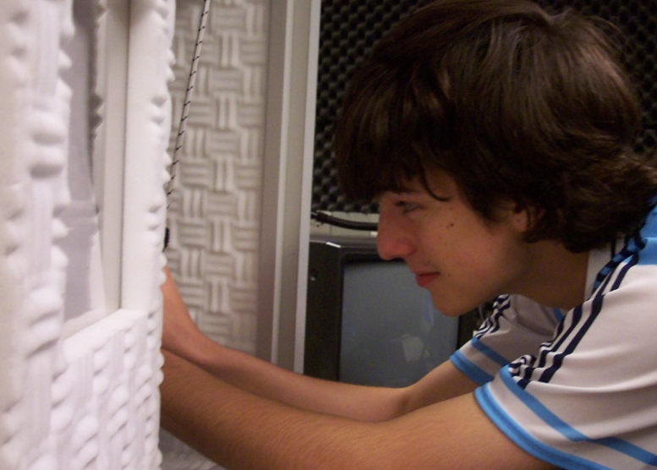
STARS GOALS (continued)
Allow participants to practice basic laboratory technologies in
an open-ended, problem-solving environment and to learn the operation of a variety of technical equipment;
Provide participants with assistance and support for continued work on independent research projects and curriculum development and implementation;

Slide 15
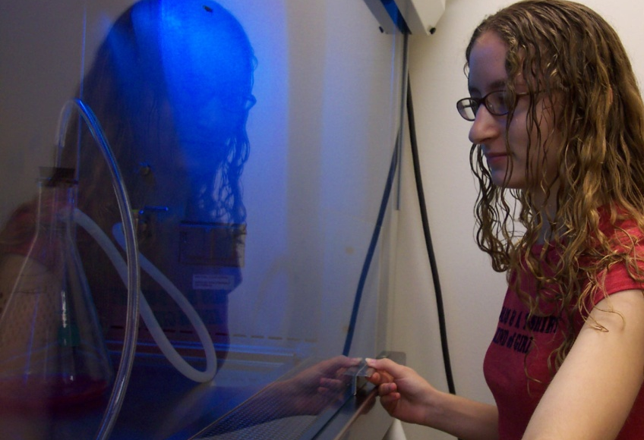
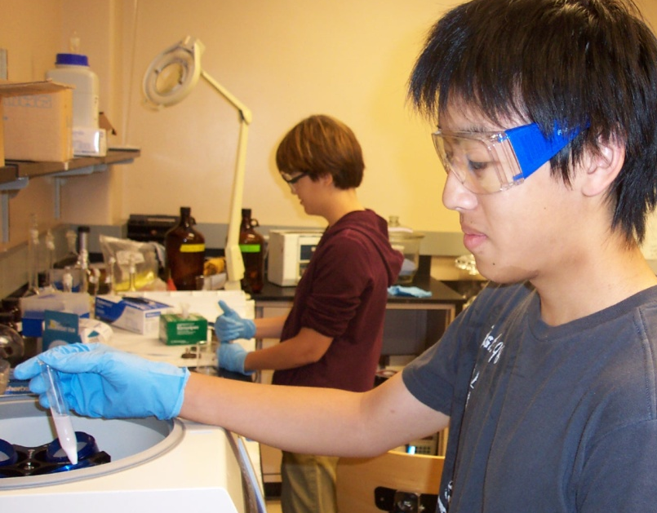
STARS GOALS (cont.)
Facilitate the development of social skills appropriate for professional and intellectual interactions, cooperation and leadership;
Provide participants with the opportunity to interact with peers of similar academic and career interests, reinforcing their goals and achievements;
Establish an electronic network between students and researchers for continued support and professional development.

Slide 16
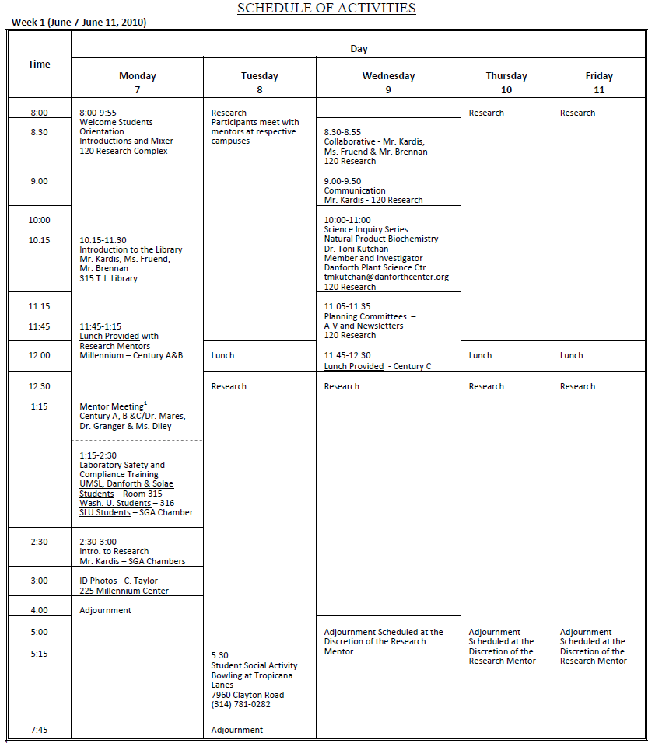
S
C
H
E
D
U
L
E

Slide 17
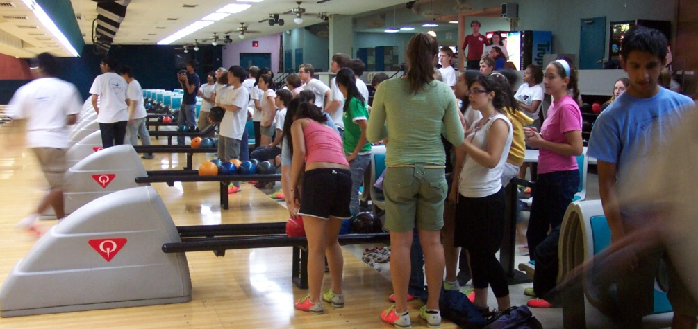
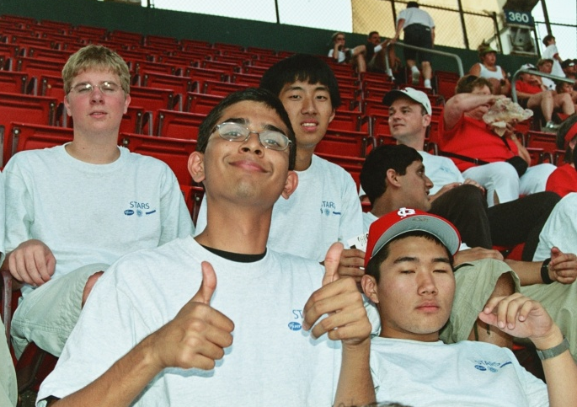
S T A R S
Social activities may include:
  Bowling, Movies
  Picnics, BBQs
  Cardinal’s Baseball
  St. Louis Symphony
  Peer-to-Peer and Mentor Networking

Slide 18
A SAMPLING OF INSTITUTIONS THAT PAST PARTICIPANTS ATTENDED
Brigham Young
Carnegie Mellon
Cornell
Creighton
Dartmouth
Drake
Duke
Emory
Florida A&M
Harvard
Johns Hopkins
MIT
Purdue
Rice
Stanford
Truman State
UCLA
U. of MO Campuses
Notre Dame
USC
Washington Univ.
Yale

Slide 19
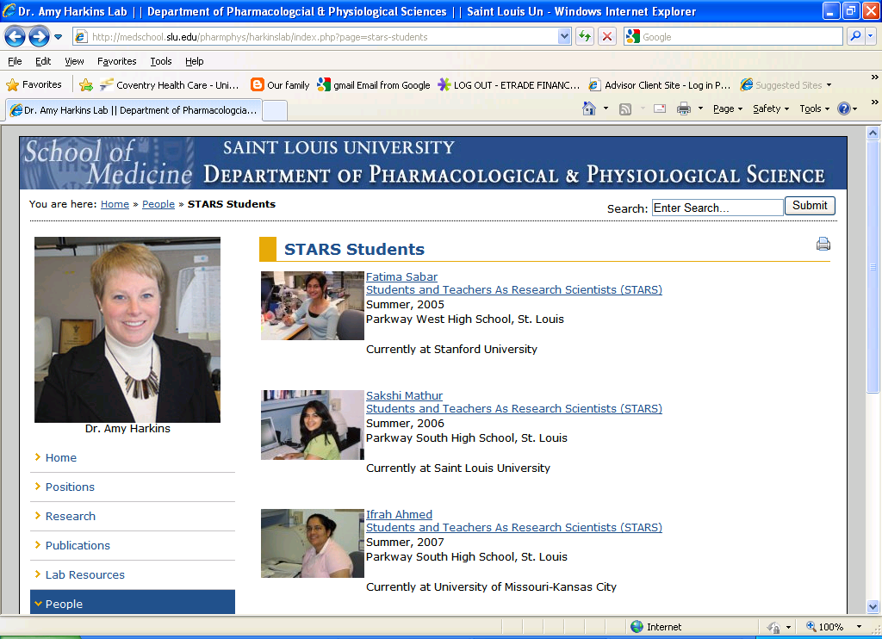
MENTOR’S WEBPAGE

Slide 20
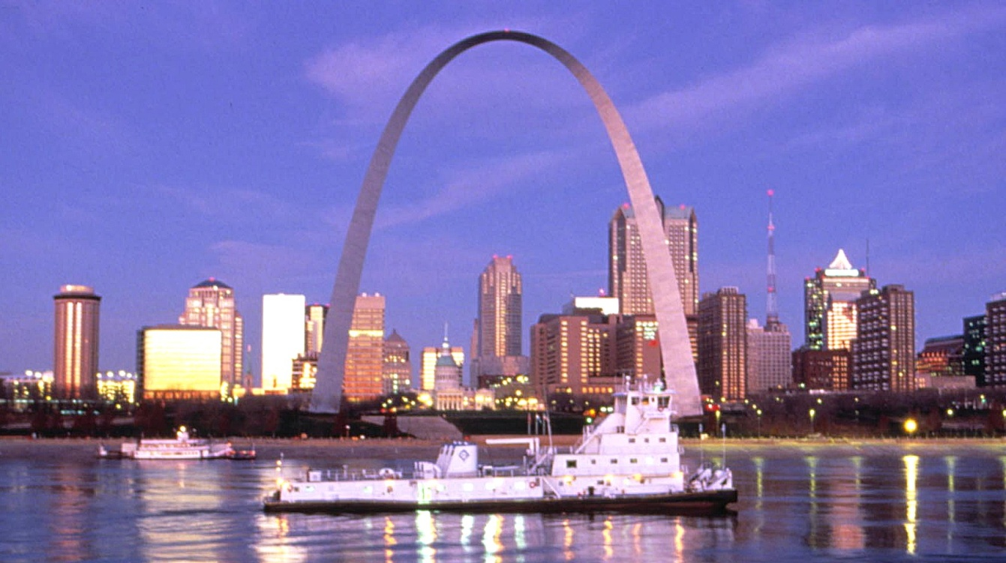
S T A R S
Applicants are limited to outstanding rising junior or senior high school students.

Slide 21
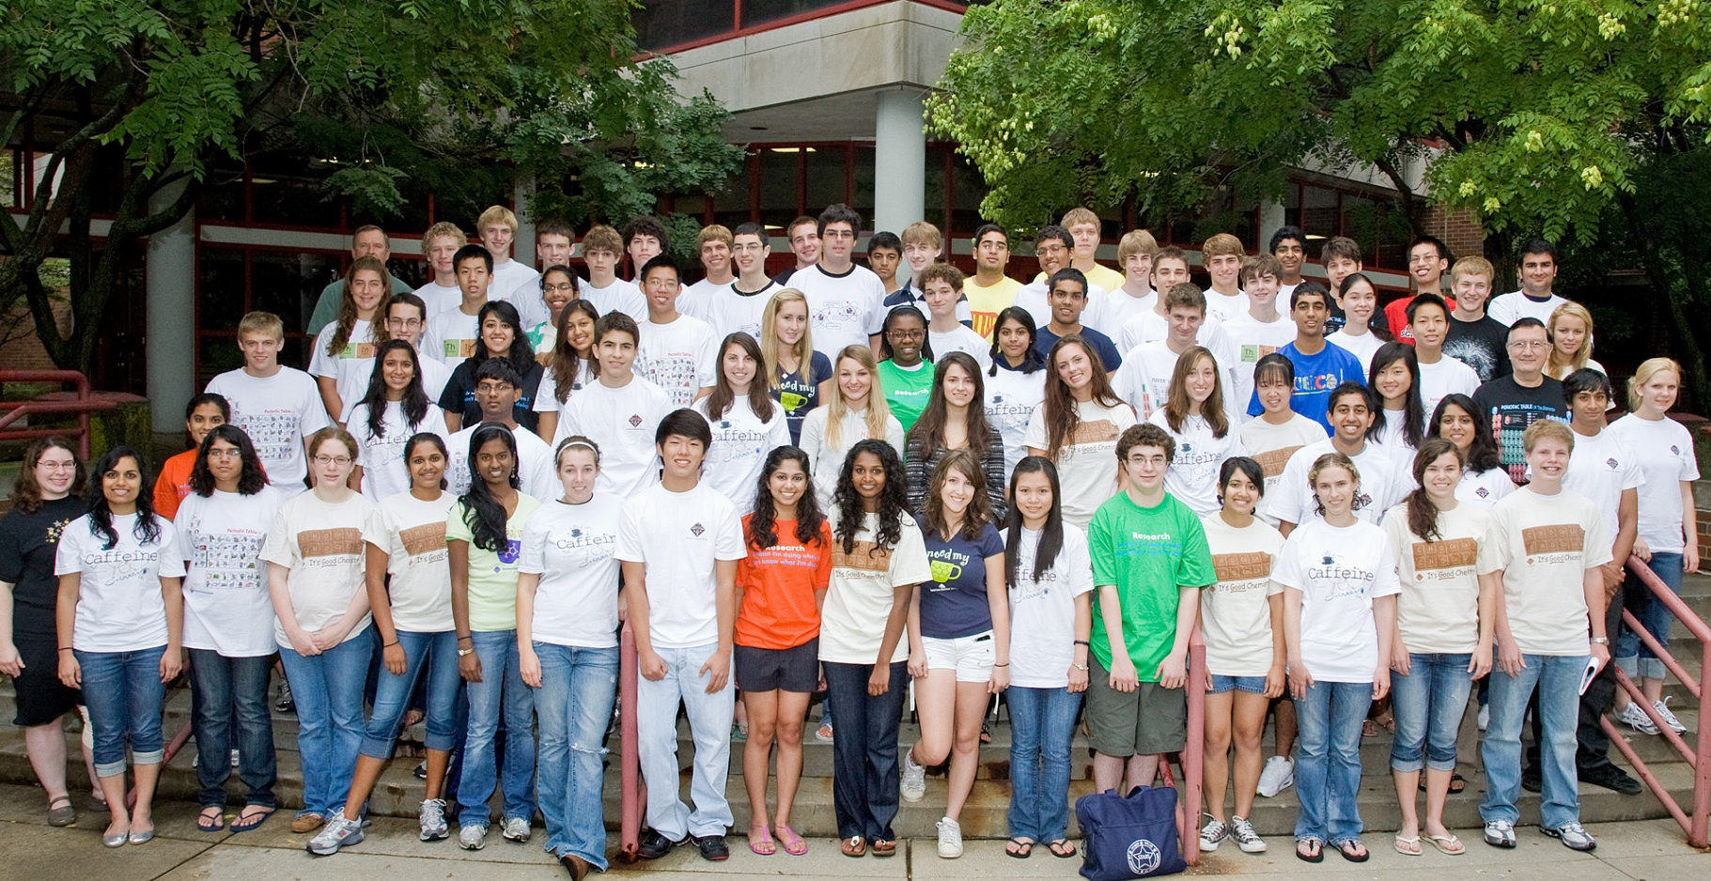
STARS PARTICIPANTS
2009

Slide 22

The University of Missouri-St. Louis
Science Education Programs
FOR STARS APPLICATION AND COST INFORMATION CONTACT:
Director, STARS Program
239 Research Complex
University of Missouri-St. Louis
One University Boulevard
St. Louis, MO 63121-4400
(314) 516-6226
E-mail: maresk@umsl.edu
www.umsl.edu/~sep/programs/stars.html

Slide 23
The University of Missouri-St. Louis
Science Education Programs
S T A R S
STUDENTS and TEACHERS
AS
RESEARCH SCIENTISTS

Slide 24
STARS SUCCESS STORIES
2009 STARS Graduate
Rishub Keelara, MICDS 2009-2010 Junior
Rishub assisted Dr. Paul Schlesinger, Washington University, in his work studying the Bax protein, which is instrumental in making apoptosis happen. Apoptosis is the process by which cells die, and when it doesn’t occur, diseases like cancer can. Keelara wrote a paper about his findings, and took such good care of his Bax protein cultures that Rice University asked for them. He is attending the 2010 summer Research Science Institute at MIT.

Slide 25
STARS SUCCESS STORIES
Sample 2008-2009 STARS Graduates
Name Institution Intended Major
Anderson, Kelsey Vanderbilt Economics
Babbra, Mandeep Saint Louis Univ. Biology (Medical
Scholar Program)
Berger, Jack Princeton Biophysics & Hockey
Bleeke, Jeremy Columbia Undecided
Cao, Erica Princeton Neuroscience
Carter, Nicole Harvard Biology/Gov’t./Lang.
Chen, Jack Duke Biomed. Engineering
Coleman, Mara U. of MO-Columbia Biochemistry
Collins, Roy Yale Pre-med. & Football
Diamond, Ricki Tulane Undecided
Dickerson, Cody U. of Pittsburg Mathematics

Slide 26
STARS SUCCESS STORIES
Sample 2008-2009 STARS Graduates
Name Institution Intended Major
Gabliani, Khira New York Univ. Business
Ghosh, Trina UMKC Medicine
Hausfater, Nate Washington Univ. Biochemistry
Huang, Marshall Purdue Chem. Engineering
Hwang, Julie UCLA Biochemistry
James, Emma McGill Univ. Science (Pre-med.)
Jemison, Michael Harvard Mathematics
Jin, Michael Yale Molecular Biophysics
& Biochemistry
Kelly, Shannon Furman Univ. Chemistry
Lally, Jack Notre Dame Biology (Pre-med.)
Li, Erin Duke Biology
Liu, Cassie Wesleyan Univ. Biochemistry
Lyss, Rebecca UM-St. Louis Engineering

Slide 27
STARS SUCCESS STORIES
Sample 2008-2009 STARS Graduates
Name Institution Intended Major
Moore, Tiffany Lindenwood Undecided
Parekh, Sejal Stanford Biology
Rajguru, Pooja U. of Arizona Bio-systems Eng.
Schwartz, Elliot U. of Illinois (C/U) Aerospace Eng.
Shocklee, Miceala CA Inst. of Technology Biomedical Eng.
Tereshchenko, Sasha U. of Michigan Honors Undecided
Wachsstock, Leah Michlalah Jerusalem Academic/Religious
Wilson, Kelly Davidson College Undecided
Xu, Sharon MIT Architecture
Yamada, Steven Cornell Plant Science
Yasin, Hassan Johns Hopkins Biomedical Eng.
Zhang, Yiliu MIT Cognitive Sciences

Slide 28
The University of Missouri-St. Louis
Science Education Programs
FOR STARS APPLICATION AND COST INFORMATION CONTACT:
Director, STARS Program
239 Research Complex
University of Missouri-St. Louis
One University Boulevard
St. Louis, MO 63121-4400
(314) 516-6226
E-mail: maresk@umsl.edu
www.umsl.edu/~sep/programs/stars.html

Slide 29
The University of Missouri-St. Louis
Science Education Programs
S T A R S
STUDENTS and TEACHERS
AS
RESEARCH SCIENTISTS

