Slide 1
Creating a Winning Linkedin Profile
Sheila Burkett
Managing Partner, Spry Digital

Slide 2
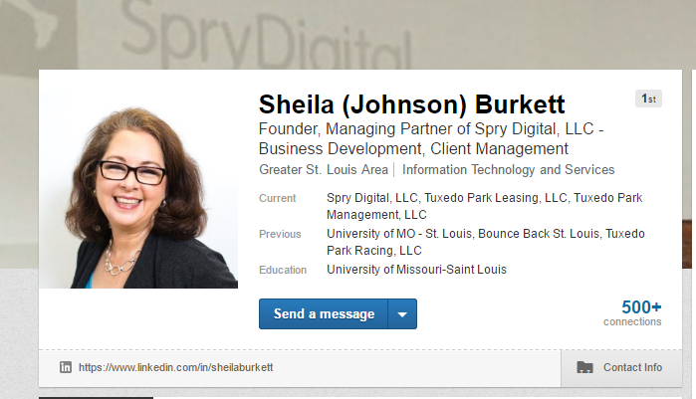

Slide 3
Why LinkedIn?

Slide 4
Why have a LinkedIn Profile?
Recruiters – Recruiters – Recruiters
Connect to Get Hired
Tell Your Story
Showcase Your Work
Become a Thought Leader
Find a Job
93% OF HIRING MANAGERS SEARCH LINKEDIN FOR RECRUITS
MARKETWATCH.COM – 05/02/2014

Slide 5
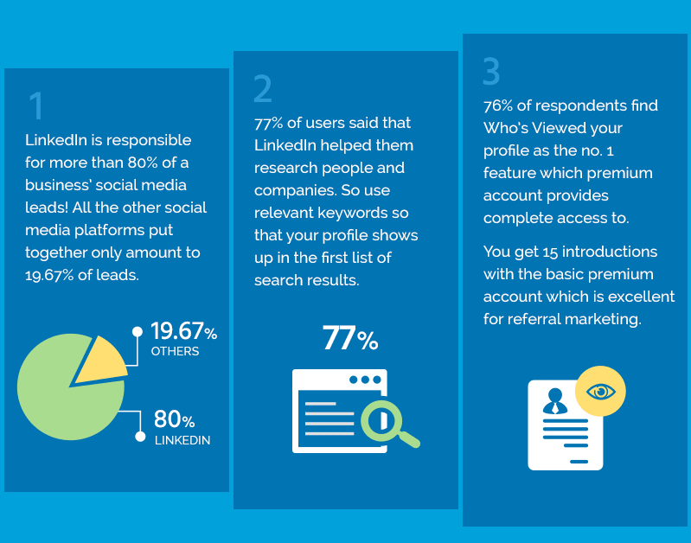
RESEARCH FROM TRUCONVERSION
VIA Forbes Magazine

Slide 6
What is Expected?

Slide 7
Qualities Employers Want to See
Able to communicate your path
Self-directed
Successful
Insightful about strengths
Independent thinker
Problem Solver
Ambitious
Proactive and takes initiative
Loves to learn new things
Goal-oriented
Works well with a team
Responsible

Slide 8
Creatives, Developers and Leaders
Provide real examples of your work.
Understand the terminology and use it correctly.
Do projects outside of the classroom.
Get involved with clubs, meetups or volunteer your skills.
Who do you read, follow and share articles from on LinkedIn.

Slide 9
Updating Your Profile

Slide 10
Step 1: Hide your updates
Before you start making lots of changes to your LinkedIn profile, be sure to hide updates from your feed. This stops everyone from seeing an update every time you save a change.
Click on your picture in the far right corner.
Select Privacy and Settings option to manage your settings.
Click Privacy.
Find the option “Sharing Profile Edits”. Switch to no.
Make your changes. When done, feel free to turn the updates back on.

Slide 11
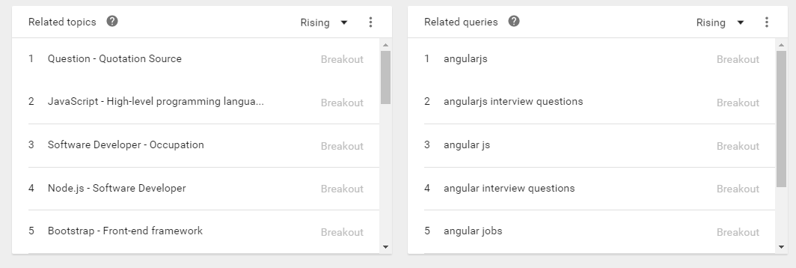
Step 2: Do Your Research
What are the keywords for your desired field?
Think about Search Engine Optimization (SEO) for your profile content.
Leverage Google Adwords’ Keyword Planner. It is free!
Look at Google Trends

Slide 12
Step 3: First Impression
Keep your profile name clean.
If you have a common name, add middle initial or suffix.
Create an action / compelling headline.
Must have a professional profile photo.
Customize your Public Profile URL (linkedin.com/in/sheilaburkett
Personalize your website link (don’t say “Personal”)
Make it easy for someone to contact you.

Slide 13
Step 4: Tell Us About Yourself
Use Document with Spellcheck first.
Write a short and direct description about yourself.
Emphasize your professional skills.
Promote your projects
Add any professional publications
Share your honors and awards
Volunteer positions, Organizations and Interest

Slide 14
Step 5: Network
Build Connections
Who to connect with?
Professors, Coaches
Family, Friends and Neighbors
Send a note when connecting. Remind people how they know you.

Slide 15
Step 6: Engage
Join Groups and participate
Follow companies
Share professional, thoughtful content
Congratulate people
Give thoughtful recommendations

Slide 16
Job Hunting

Slide 17
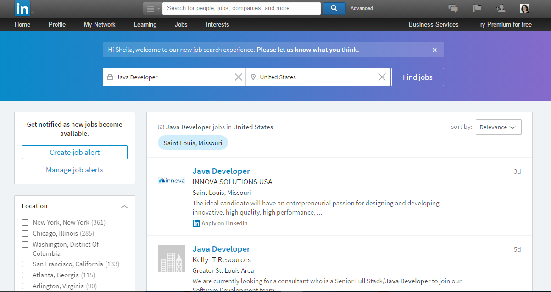

Slide 18
Creating a Winning LinkedIn Profile
Hide your updates
Do your research
Make a great first impression
Tell your story
Network
Engage

Slide 19
Questions? Connect with me @Saburkett @sprydigital facebook.com/sprydigital Linkedin.com/company/Spry_digital_llc

