Slide 1
Chapter 7 DESIGNING A DECISION SUPPORT SYSTEM
Decision Support Systems
For Business Intelligence

Slide 2
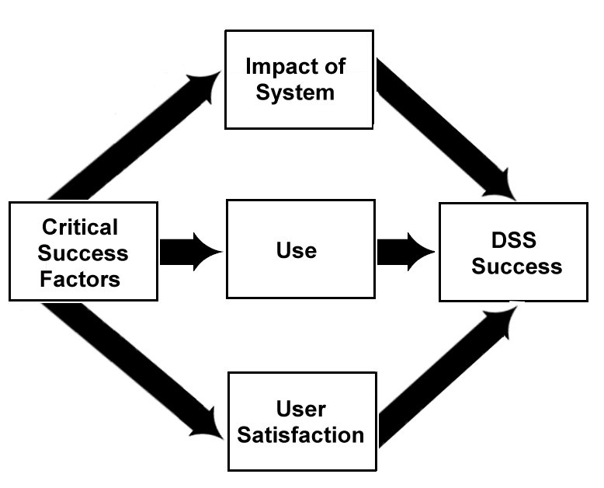
Figure 7.1: A Model of DSS Success

Slide 3
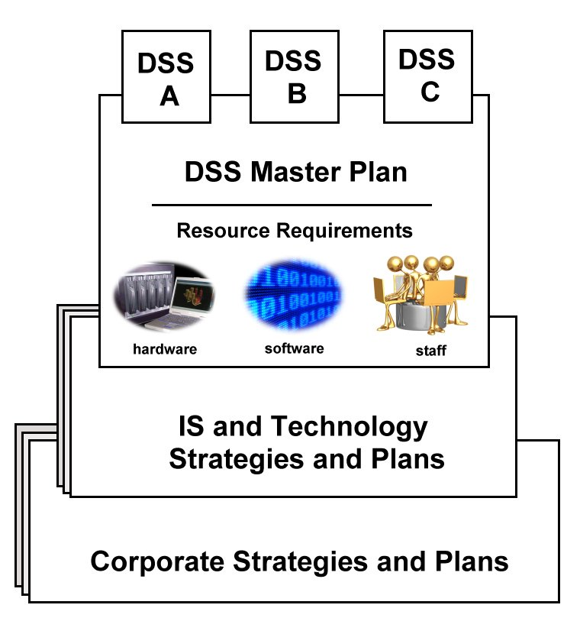
Figure 7.2: Ideal Planning

Slide 4
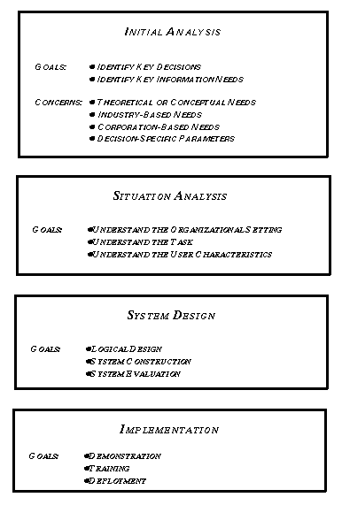
Figure 7.3: DSS Design Methodology

Slide 5
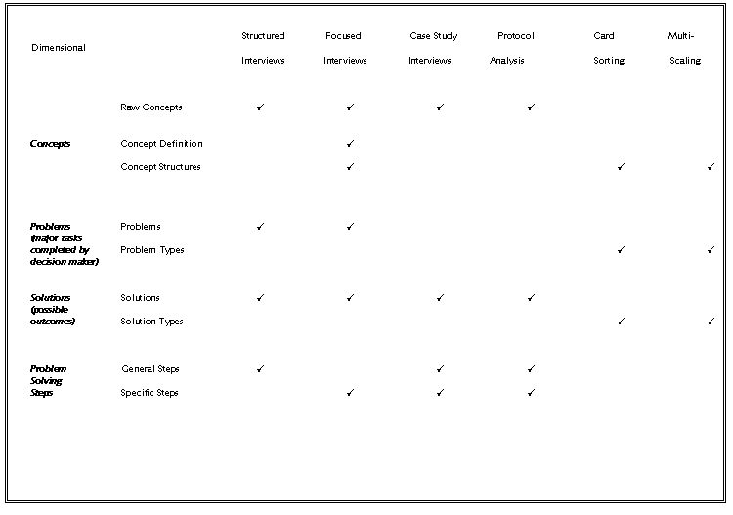
Figure 7.4: Interviewing Techniques Matrix

Slide 6
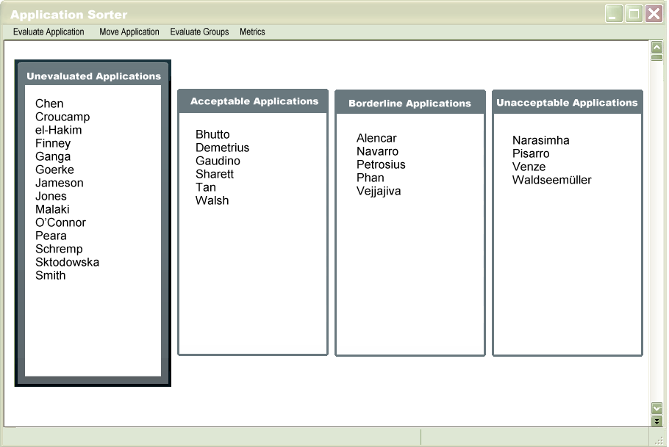
Figure 7.5: Card Sorts Simulation

Slide 7
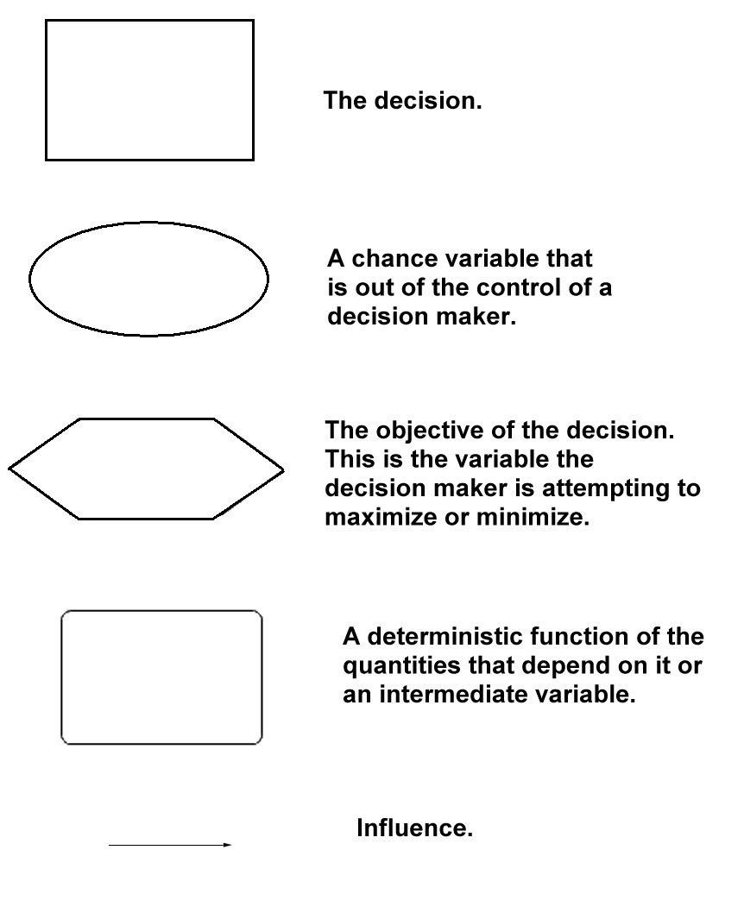
Figure 7.6: Influence Diagram Symbols

Slide 8
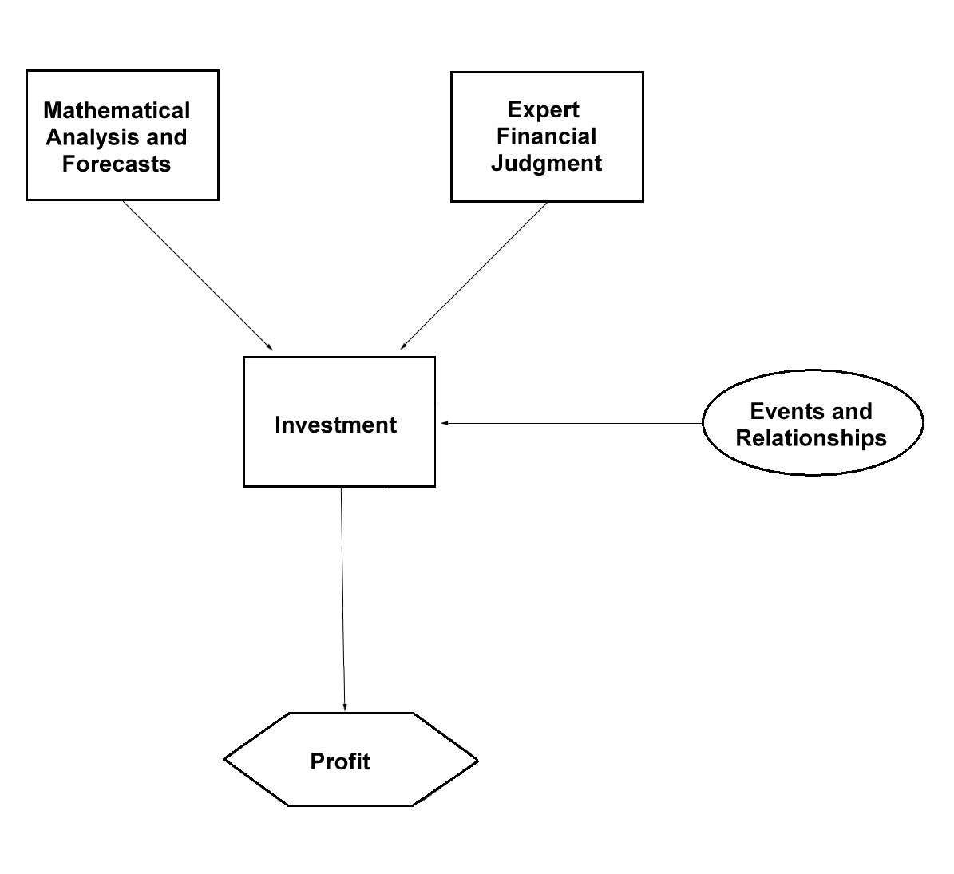
Figure 7.7: An Influence Diagram

Slide 9
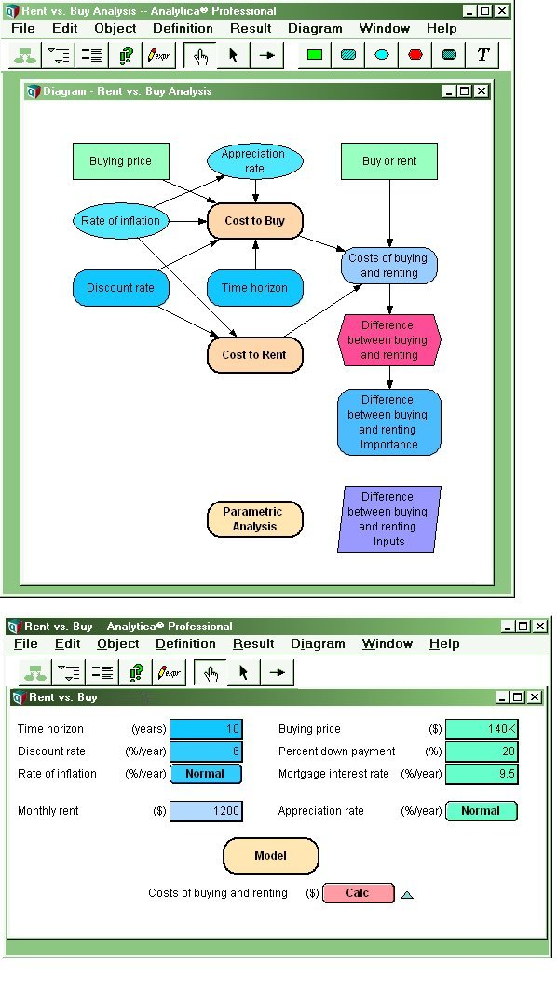
Figure 7.8: An Influence Diagram in Analytica

Slide 10
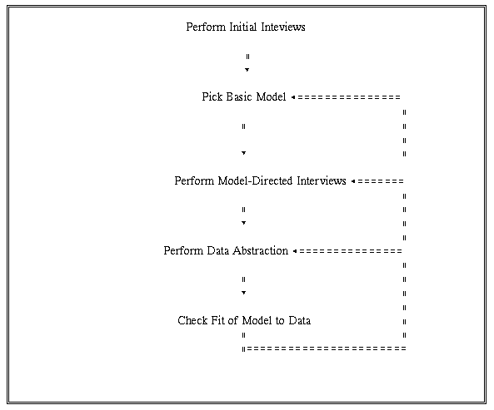
Figure 7.9: Iterative Nature of Situation Analysis

Slide 11
Table 7.1: Design Approaches
One-Stage, Complete System
Quick-Hit
Evolutionary Development

Slide 12
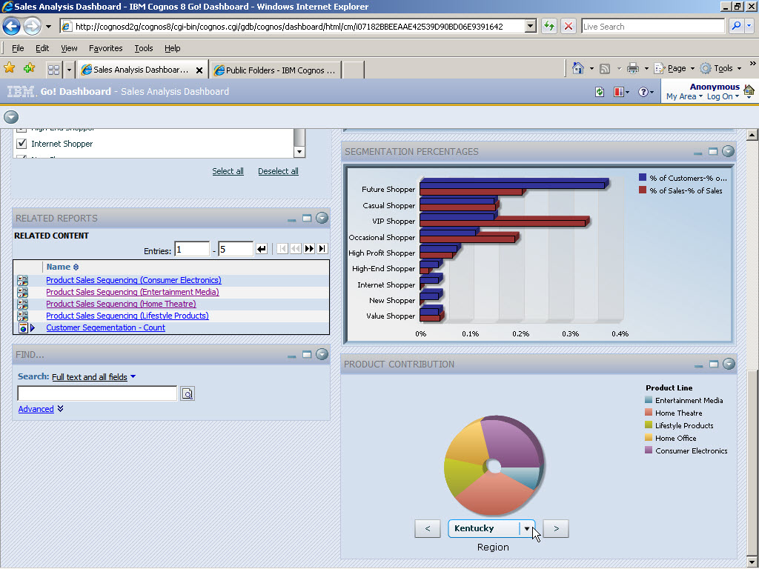
Figure 7.10: Example DSS Appliance-Cognos

Slide 13
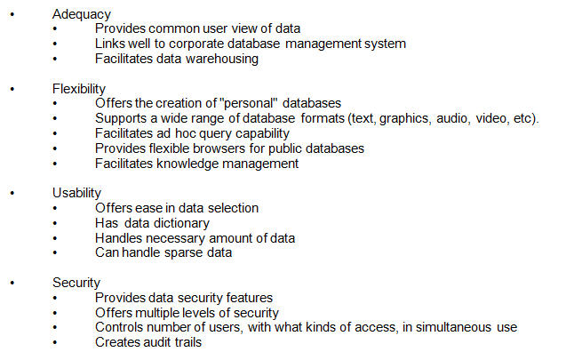
Table 7.2: Data and Data Management Concerns in Selecting a DSS Generator

Slide 14
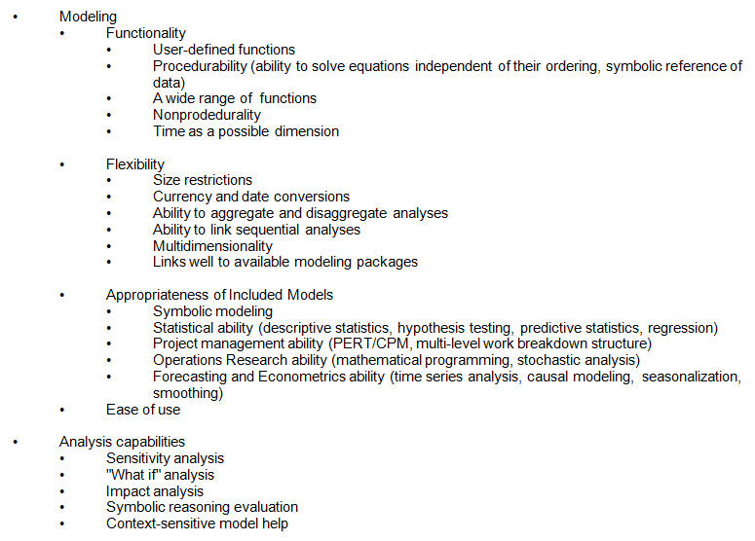
Table 7.3: Models and Model Management Concerns in Selecting a DSS Generator

Slide 15
Table 7.4: User Interface Concerns in Selecting a DSS Generator
User friendliness
Novice and expert modes
Menus and Prompts
Consistent, natural language commands
Command abbreviations
Context-sensitive Help
Clear, end-user-oriented error messages
“Undo” command support
Meaningful identifiers
Documentation
User-defined commands
Context-sensitive warnings
Support of modeling and data needs
Wide range of graphics support
Windowing support
Multitasking support
Support for a variety of input and output devices
Color and functional control over user interface
Support for individual customization

Slide 16
Table 7.4: User Interface Concerns in Selecting a DSS Generator Continue
Graphics
Quality and resolution of output
Multicolor support
Range of output control
Support for dynamic graphics, video and audio enhancements
Basic plots and charts
Complex charts
Format and layout control
Spacing of graphs
Compatibility with available graphics devices
Preview ability
Modification ability
Ease of use
Reporting formats
Supports a range of platforms
Flexibility of reporting formats
Standard formats
Ease of customization
Standard symbols and conventions

Slide 17
Table 7.5: Connectivity Concerns in Selecting a DSS Generator
Compatibility with available electronic mail system
Document sharing
Data sharing
Communications
Mail-handling and priority-setting code
Connectivity to Internet resources, including news services, and Web pages
Electronic searching devices for Internet resources
Firewall availability

Slide 18
Table 7.6: Hardware and Software Concerns in Selecting a DSS Generator

Slide 19
Table 7.7: Cost Concerns in Selecting a DSS Generator
• Initial purchase/license cost
• Per capita fee
• Maintenance costs
• Documentation
• Resource Utilization
• Conversion Costs
• Upgrade frequency and costs

Slide 20
Table 7.8: Vendor Concerns in Selecting a DSS Generator
• Financial Stability and Viability
• Length of time in business
• Size of installed base
• Growth in customer base
• Quality and size of staff
• Activity of R&D Staff
• Ongoing commitment to this product
• Technical Support personnel
• Availability of support hot line
• Availability of Internet-based support
• Time horizon for Support
• Internet User-Discussion Group
• Organized User Group
• Product Target Market
• User Perceptions

Slide 21
Table 7.9: Characteristics of Good Team Members
• Creativity and openmindedness.
• Good communication skills.
• An understanding of the decision task and the organization, business and marketplace.
• An understanding of and experience with DSS design and/or use.
• An understanding of possible technology.
• A willingness to work cooperatively.
• Good chemistry between the design team and the use team.

Slide 22
Table 7.10: Tenets of Effective Communication
• It is impossible to use too much communication.
• Simplify your message, no matter how complex the issue.
• Anticipate the issues and communicate your position early.
• Don't underestimate the technical requirements of a communications project.
• Involve all levels of management where appropriate.
• Honesty is the best policy. Tell the truth.
• Identify and know your audiences.

