Slide 1
The Future of Computing May Depend on YOU!
Vicki L. Sauter
Professor of Information Systems
University of Missouri – St. Louis

Slide 2
Computer Technology is Important
Computing is one of the fastest growing occupations: Employment projections claim there will be more than 800,000 new high-end computing jobs by 2018
Five of the top ten fastest growing jobs will be in computing-related fields
Contrary to what you might read, computer science, information systems, and computer engineering bachelor degrees are in high demand, and command two of the top three average salary offers from employers among all majors this year
Borrowed from: http://www.csedweek.org/key-facts

Slide 3
What Problem Are We Solving?
How can we get better software?

Slide 4
Developing Software Success
Oxford University Study of IT
Successful Software: 16%
Challenged Software: 74%
Abandoned Software: 10%
National Institute of Standards and Technology (NIST)
Software defects cost nearly $60 Billion Annually
80% of development costs involve identifying and correcting defects

Slide 5
Why is Development Flawed?
Many hypotheses about the failure
Poor choice of Languages
Inappropriate or Missing Methodologies
Poor Requirements Definitions
Not including the User in the Process
Makeup of the Design and Coding Teams

Slide 6
Diversity provides teams the opportunity to tap into multiple, unique perspectives on the task

Slide 7
Software Development Success
Diversity in team make up is critical to success
Gender
Race
Background
Skills
Personality
Recent research: more women on a team lead to a better outcome!

Slide 8
Ada, the Countess of Lovelace
Only legitimate daughter of the poet, Lord Byron
English Mathematician

Slide 9
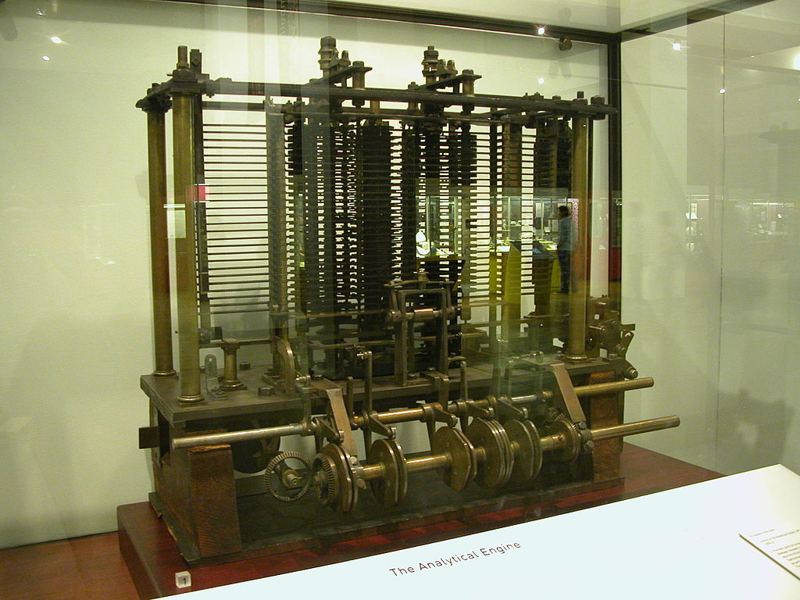
Programmer for Charles Babbage’s Analytical Engine
FIRST EVER PROGRAMMER!

Slide 10
Henrietta Swan Leavitt
Joined the Harvard “computers“ in 1893
This group of women engaged in the production of astronomical data

Slide 11
Hedy Lamarr
Austrian Actress
Invented early technique for spread spectrum communications and frequency hopping – the foundation for Wireless Communications

Slide 12
Original Programmers of the ENIAC
Jean Bartik *
Betty Snyder
Frances Spence
Kay McNulty
Marlyn Wescoff
Ruth Lichterman

Slide 13
Grace Murray Hopper
Rear Admiral in the U.S. Navy
one of the first programmers of the Harvard Mark I
Developed the first compiler for a computer language
Popularized the machine – language independence
Considered the “mother” of COBOL
One of the first programming languages
Still the most widely used language for business applications
Coined the term “bug” for a computer problem

Slide 14
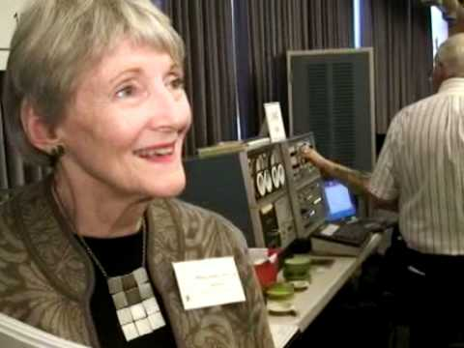
Mary Allen Wilkes
First person to design a computer for home use
She designed the multiply macromodule

Slide 15
Frances E. Allen
Excelled at program optimization and compiling for parallel computers
First woman to become an IBM Fellow
First woman to receive the Turing Award

Slide 16
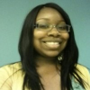
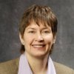
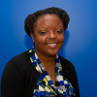
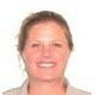
UMSL I.S. Graduates
Sheila Burkett Chantal Rivadeneyra Renita Reed
Owner, Spry Digital Internal Auditor, Nestle IT Change Management Analyst, Formerly, Partner, Edward Jones Scottrade
Susan Meyer Jahnene Nicks Margaret Shoptaw
Senior Business Leader, IT Developer, Sales Engineer,
Information Governance Boeing Global 500 Manufacturing Accounts
MasterCard Dell

Slide 17
National Organizations
Anita Borg Institute for Women and Technology (anitaborg.org)
Google Summer of Code
ABI LeanIn Circles
Systers
Black Girls Code (blackgirlscode.com)
Summer of Code
Code.org
LinuxChix (linuxchix.org)
Email lists and IRC Chats
National Council for Women in Technology
Aspirations in Computing (aspirations.org)
K-12 Alliances

Slide 18
Local Opportunities
Aspirations in Computing (aspirations.org)
Coder Girl (https://www.facebook.com/groups/416698925139566/)
DigiGirlz (slsc.org/digigirlz-2013)
Girls Dreaming Big (girlsdreamingbig.com)
Prosper Youth and Collegiate (prosperstl.com/youth-collegiate)
STEM in the Classroom (stem.stlouisparish.org/scratch)
STEMpact (stempact.org/)
Washington University Computer Camps (http://www.idtech.com/locations/missouri-summer-camps/st-louis/id-tech-washington-university)
Xtreme IT! (http://xtremeit.umsl.edu)

Slide 19
How to Find Me
Email: vicki.sauter@umsl.edu
WebPage: http://www.umsl.edu/~sauterv
Facebook: Vicki TheGeek Sauter
Twitter: @VLSauter
LinkedIn: Vicki Sauter
Instagram: vicki.sauter
This Presentation: http://www.umsl.edu/~sauterv/womeninit.pptx

Slide 20
Questions?

