Slide 1
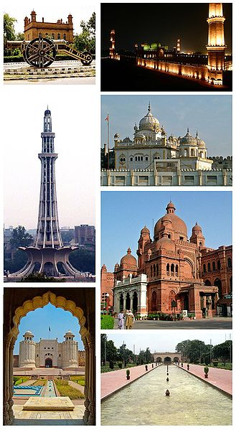
Pakistan - Lahore
In the Punjab Region

Slide 2
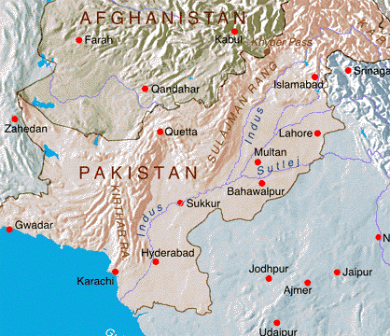

Slide 3
Climograph

Slide 4
Background
Lahore is the capital of the Pakistani province of Punjab and the second largest city in Pakistan after Karachi. Historically the main city of the undivided Punjab,^{[4]} it is often called the Garden of Mughals because of its rich Mughal heritage. It successively served as provincial/regional capital of the empires of the Shahi kingdoms in the 11th century, the Ghaznavids in the 12th century, the Ghurid State in the 12th and 13th century, the Mughal Empire in the 16th century, the Sikh Empire in the early 19th century, and it was the capital of the Punjab region under the British Raj in the mid 19th and early 20th century. Lahore is often referred to as the cultural heart of Pakistan, as it is the center of Pakistani arts, films and intelligentsia.

Slide 5
Oriental Rug Merchant

Slide 6
Mughal Architecture

Slide 25
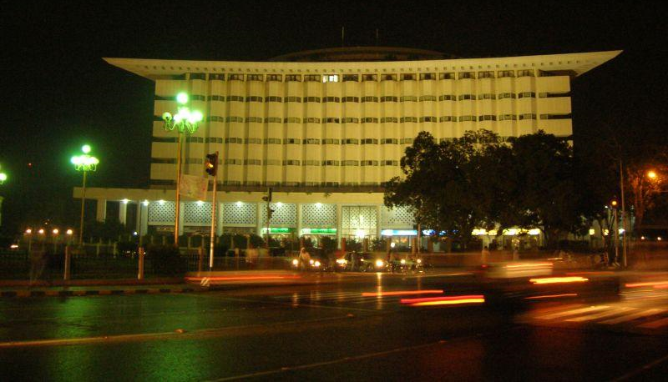
The modern side of lahore

