Slide 1
INDIA – Varanasi on the Ganges
Holy City & Holy River

Slide 2
Varanasi
Varanasi, also commonly known as Benares or Banaras and Kashi, is a city situated on the banks of the River Ganges in the Indian state of Uttar Pradesh, regarded as holy by Hindus, Buddhists, and Jains. It is one of the oldest continuously inhabited cities in the world and probably the oldest of India.

Slide 4
Ganges River
The Ganges is the largest river of the Indian subcontinent, flowing east through the Gangetic Plain of northern India into Bangladesh. The 1,560 mile river rises in the western Himalayas in the Uttarakhand state of India, and drains into the Sunderbans delta in the Bay of Bengal. It has long been considered the holiest of all rivers by Hindus and worshiped as the goddess Ganga in Hinduism.

Slide 6
Note from Fardeen
My Friend spent a week in Varanasi at the end of March and this is a selection of the pictures she took. She walked around in the Old Town (Godaulia), visited a fort and a village on the opposite bank of the Ganges, and took a river boat one early morning.
Note from J.Naumann: Some photos from Wikipedia were added to those posted by Fardeen.

Slide 9
People performing Hindu ceremony at one of the ghats of Varanasi

Slide 14
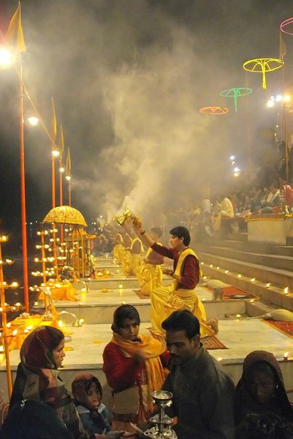

Slide 20
Economy & Commerce
Varanasi has several small cottage industries, including Banarasi Silk sari making, the production of textiles such as hand-woven carpets, and handicrafts. Banarasi paan (betel leaf) and khoa (a milk product) are popular, and the related small-scale industries employ many people. Varanasi is a centre of Child labour.

Slide 25
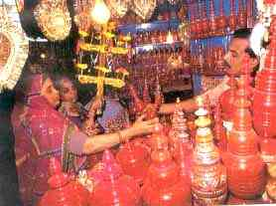
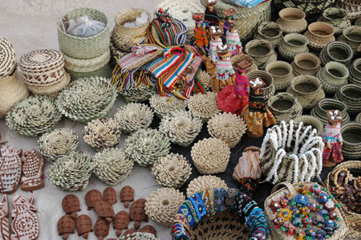

Slide 26
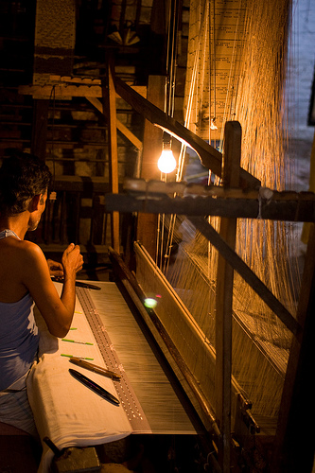
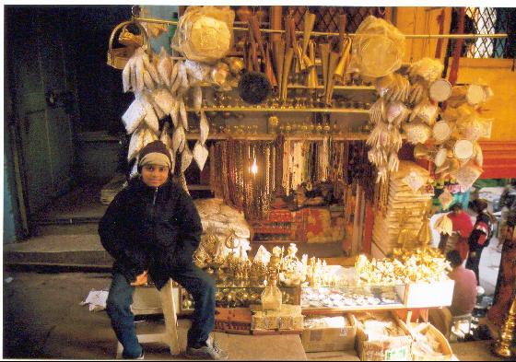

Slide 27
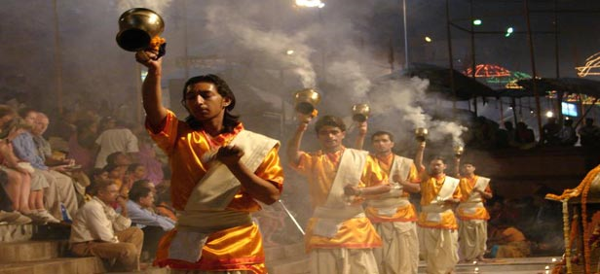
Temples & religious rituals

Slide 28
Kashi Vishwanath Temple
Kashi Vishwanath temple is one of the most famous Hindu temples dedicated to Lord Shiva and is in the holy city of Varanasi, India. The temple stands on the western bank of Hinduism's holiest river Ganges, and the deity is one of the twelve Jyotirlingas the holiest of Shiva deities. The main deity is known by the name Vishwanatha or Vishweshwara meaning the Ruler of the universe.

Slide 29
Kashi Vishwanath Temple

Slide 30
